Slide 1
Proven Winners®
2020-2021 New Arrivals

Slide 2
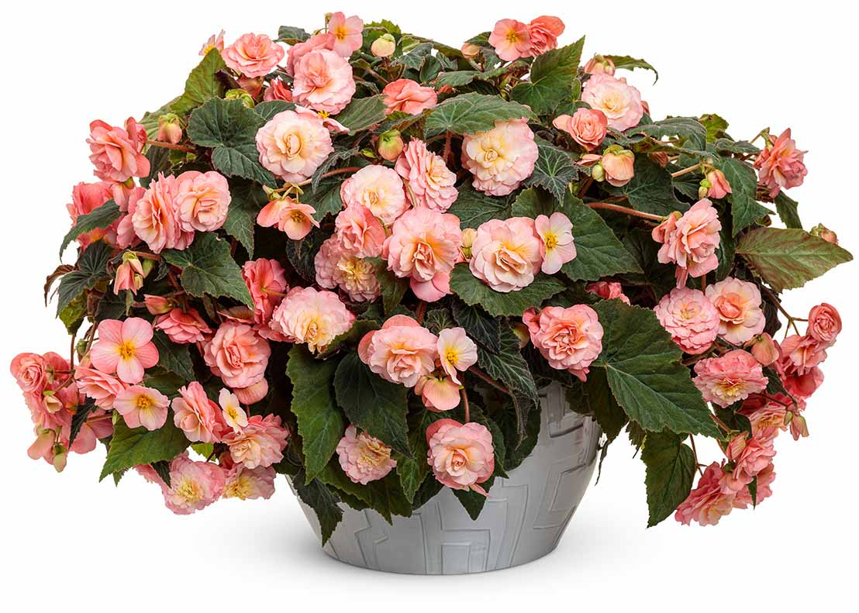
Double Delight™ Blush Rose
Begonia
WHAT’S NEW
An abundance of cascading, soft pink blossoms exude a pleasant, citrus-like fragrance. Increased vigor, branching, flower count and sun tolerance make this new begonia a delight to grow.
More tolerant of Xanthomonas than other series
Grow in 4.25 Grande™ containers, hanging baskets, window boxes and monocultures
8-14” height; 12-24” spread
Part sun to sun (full sun in the North)
Vigor 2

Slide 3
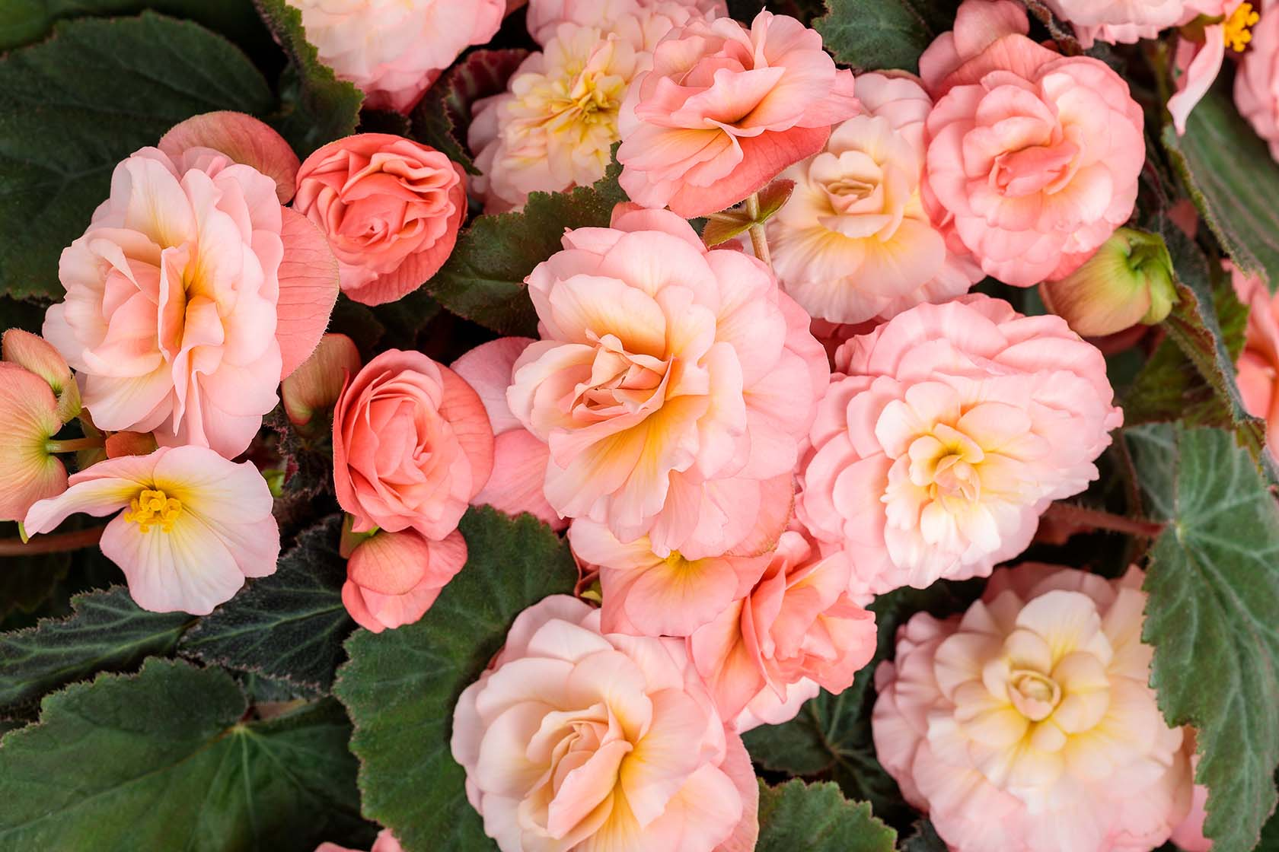
Double Delight™ Blush Rose

Slide 4
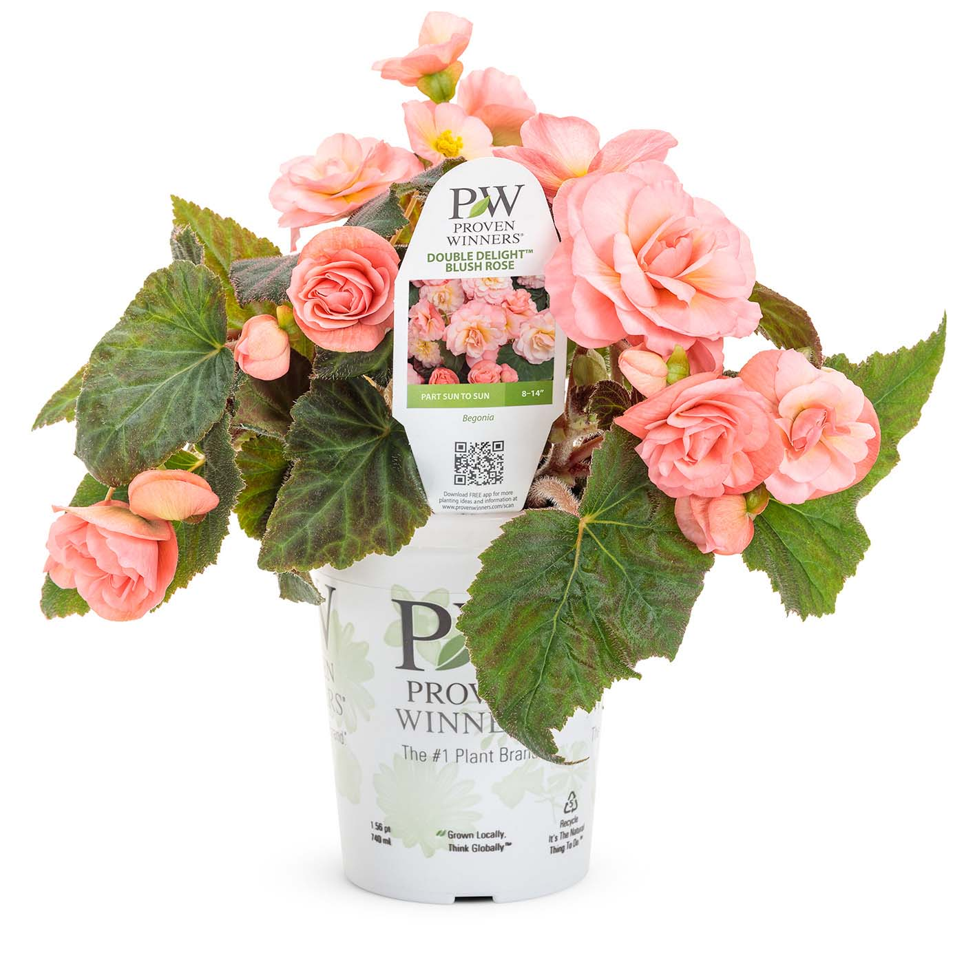
Double Delight™ Blush Rose

Slide 5
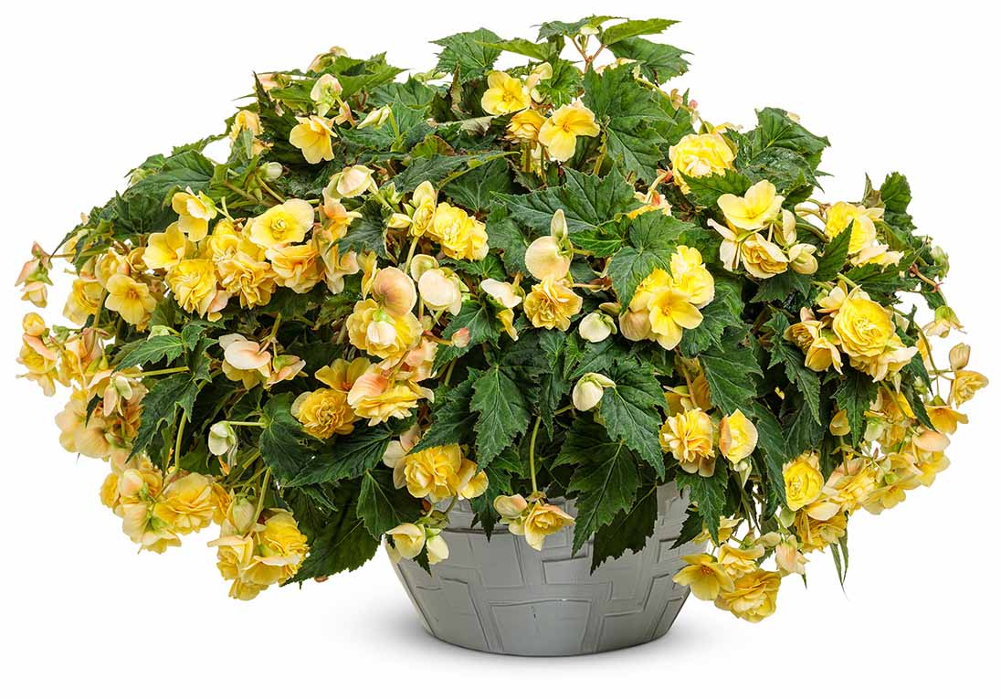
Double Delight™ Primrose
Begonia
WHAT’S NEW
Cascading, elegantly formed, soft yellow blossoms exude a notable, citrus-like fragrance. Excellent vigor, branching, flower count and sun tolerance make this new begonia a delight to grow.
More tolerant of Xanthomonas than other series
Grow in 4.25 Grande™ containers, hanging baskets, window boxes and monocultures
8-14” height; 12-24” spread
Part sun to sun (full sun in the North)
Vigor 2

Slide 6
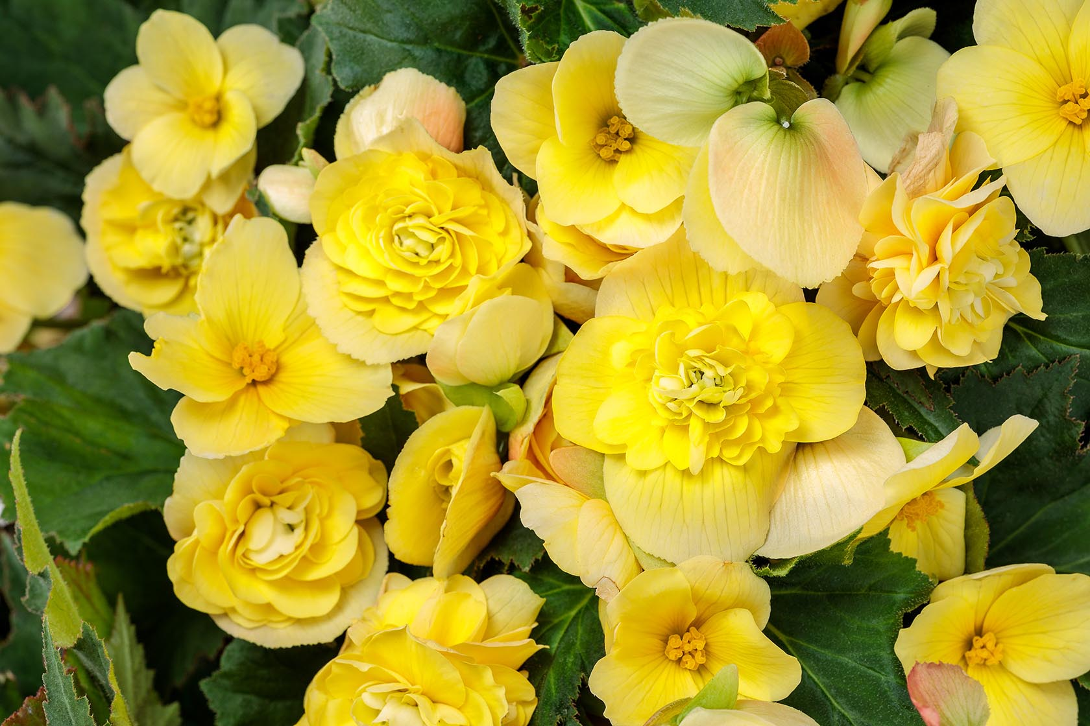
Double Delight™ Primrose

Slide 7
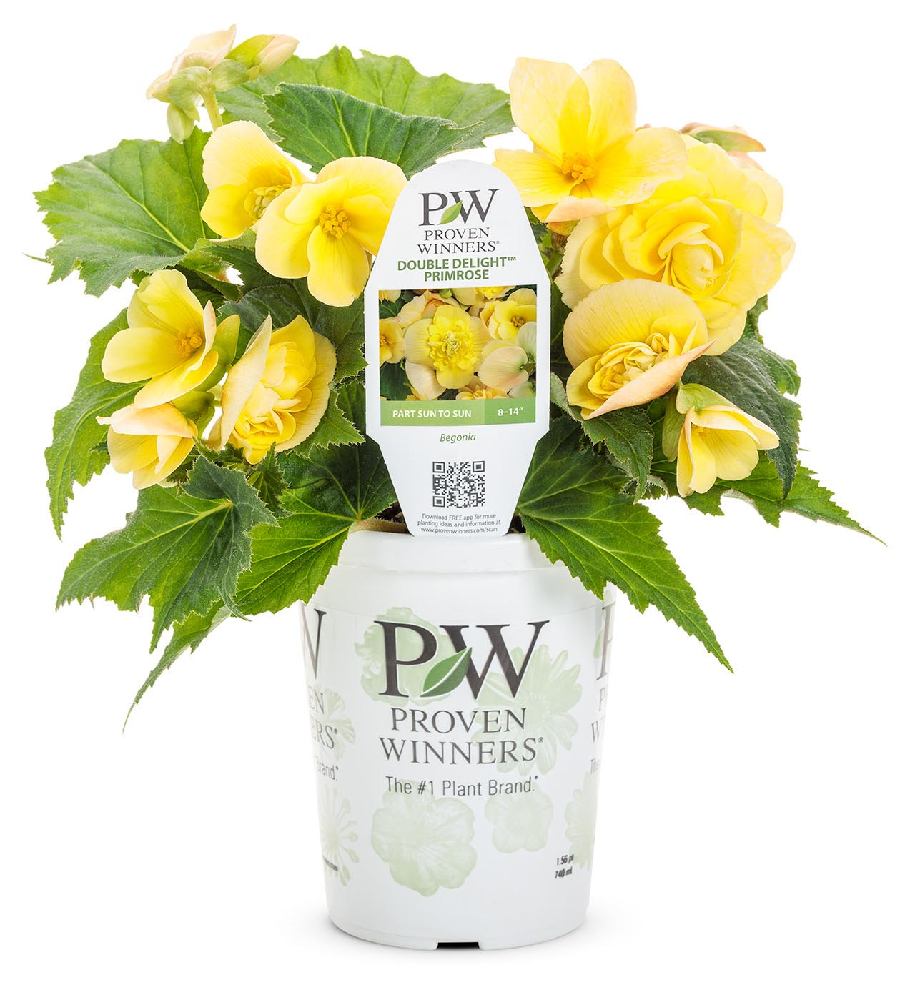
Double Delight™ Primrose

Slide 8
Double Up™ Pink Begonia
Begonia
WHAT’S NEW
This new vegetative wax begonia makes an outstanding 4” crop in production; blooms early and goes long. Plants have excellent vigor with a dense habit and double pink flowers.
Self-cleaning flowers reduce the incidence of botrytis
Daylength neutral; can be produced any time of year
Grow in 4.25 Grande™ containers, monocultures and landscapes
8-18” height; 8-14” spread
Sun or shade
Vigor 2

Slide 9
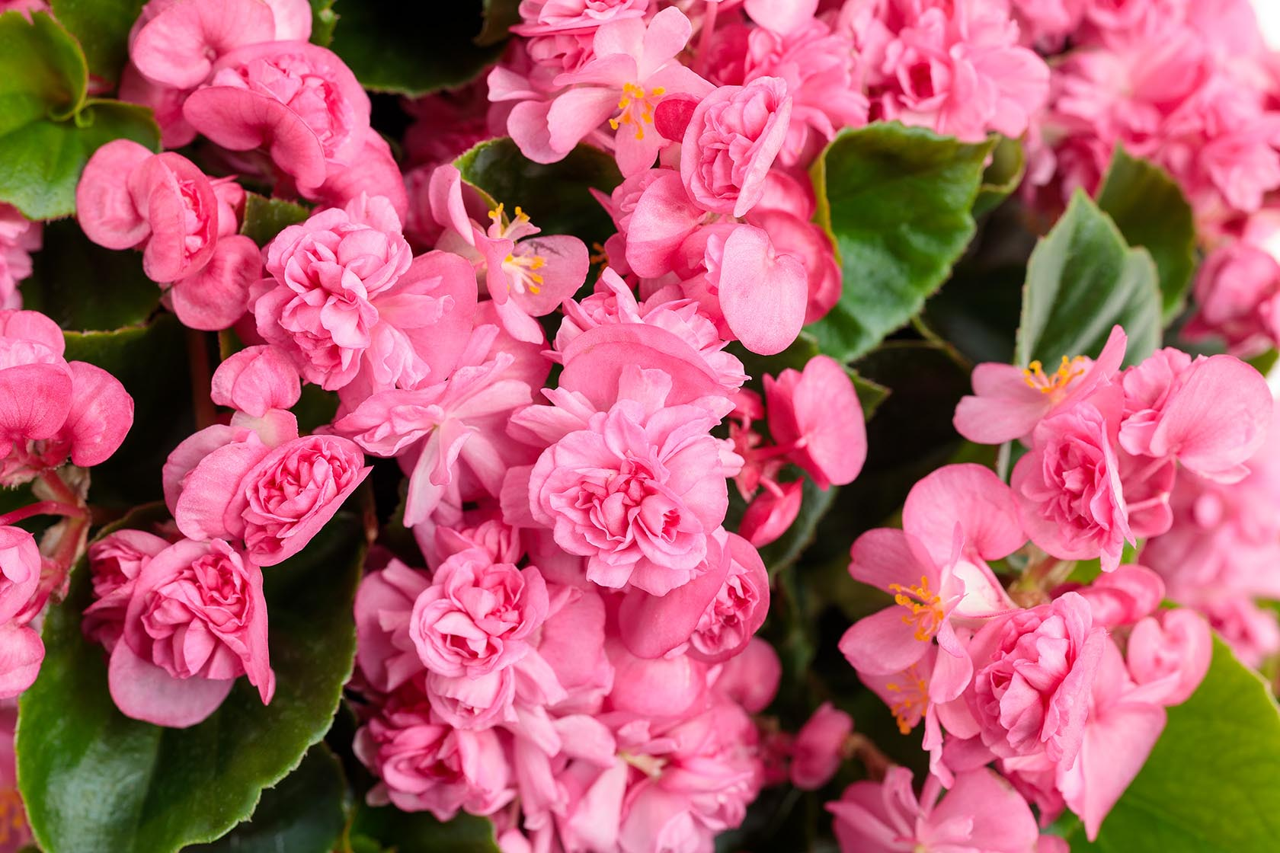
Double Up™ Pink

Slide 10
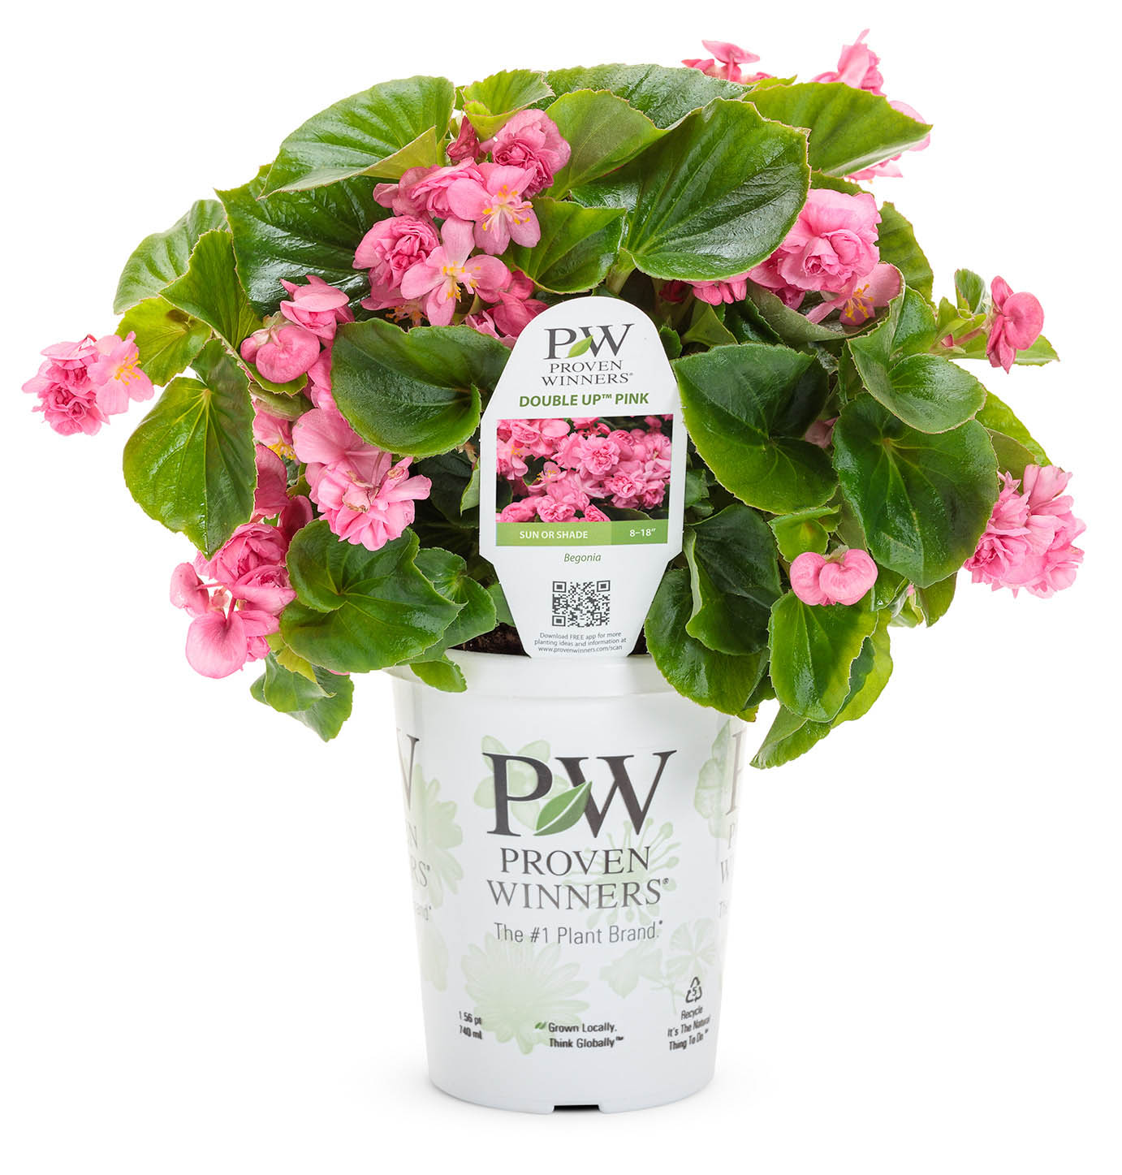
Double Up™ Pink

Slide 11
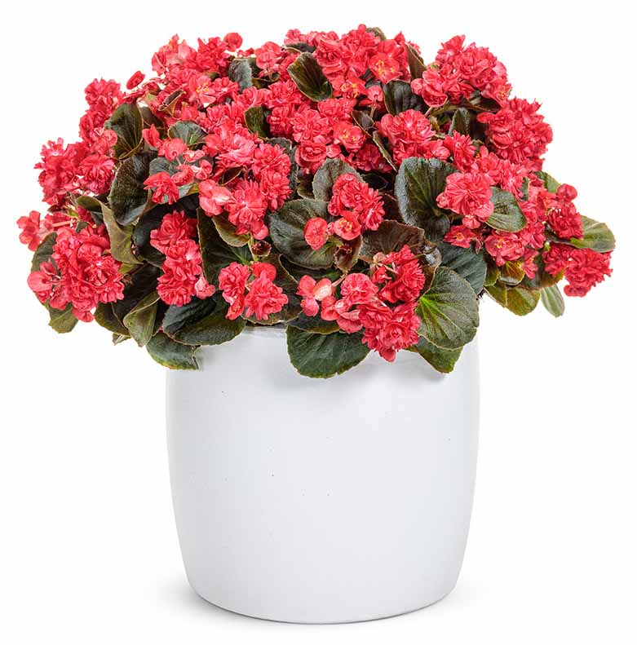
Double Up™ Red Begonia
Begonia
WHAT’S NEW
This new vegetative wax begonia makes an outstanding 4” crop in production; blooms early and goes long. Plants have excellent vigor with dark foliage and double red flowers.
Self-cleaning flowers reduce the incidence of botrytis
Daylength neutral; can be produced any time of year
Grow in 4.25 Grande™ containers, monocultures and landscapes
8-18” height; 8-14” spread
Sun or shade
Vigor 2

Slide 12
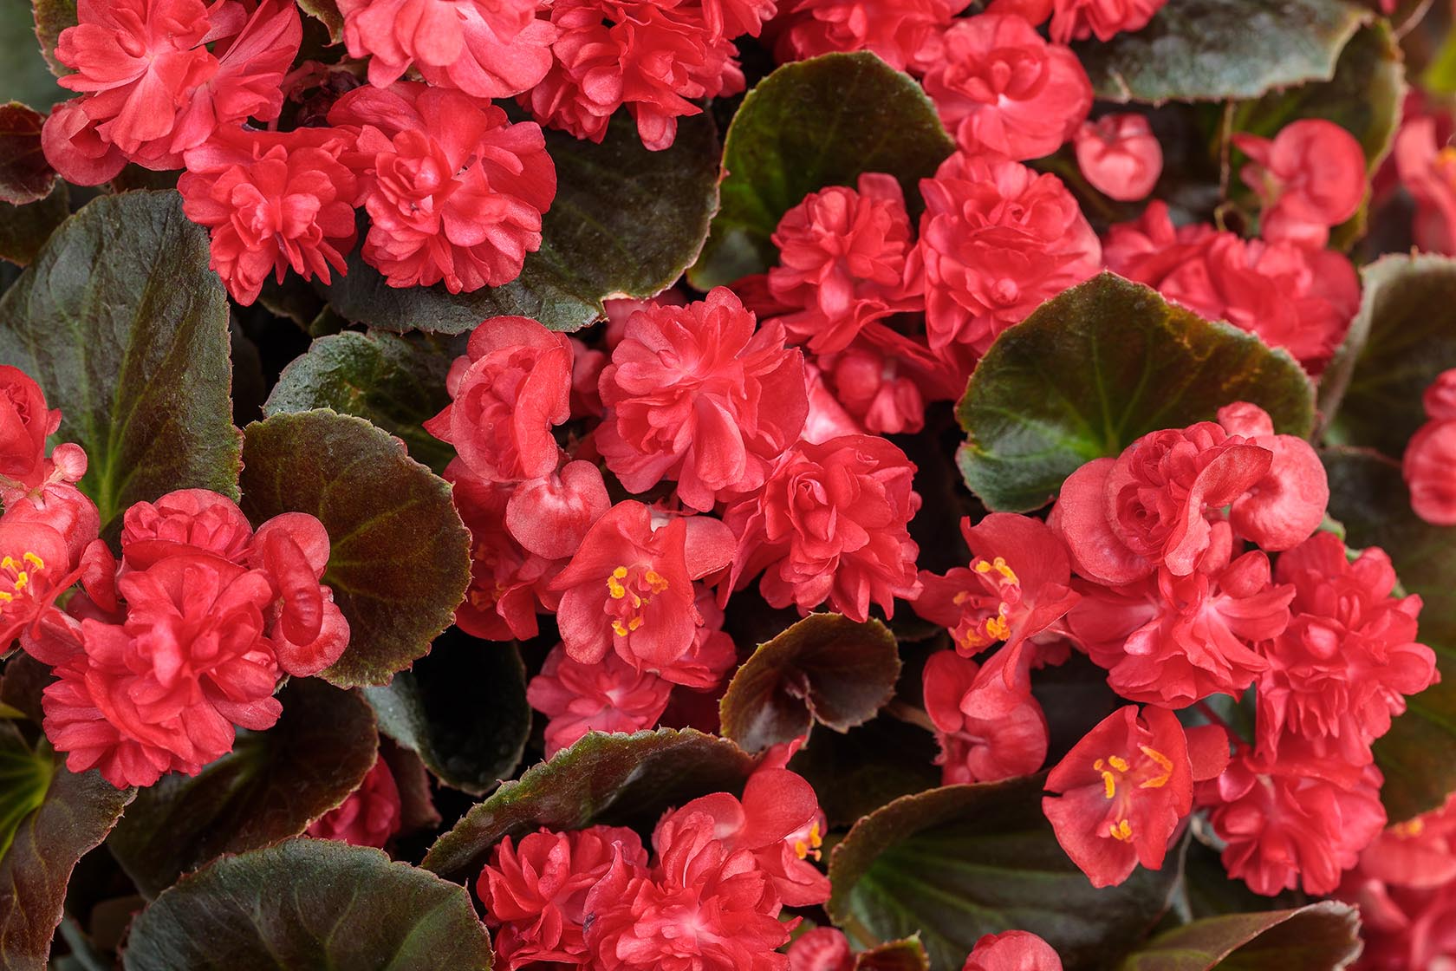
Double Up™ Red

Slide 13
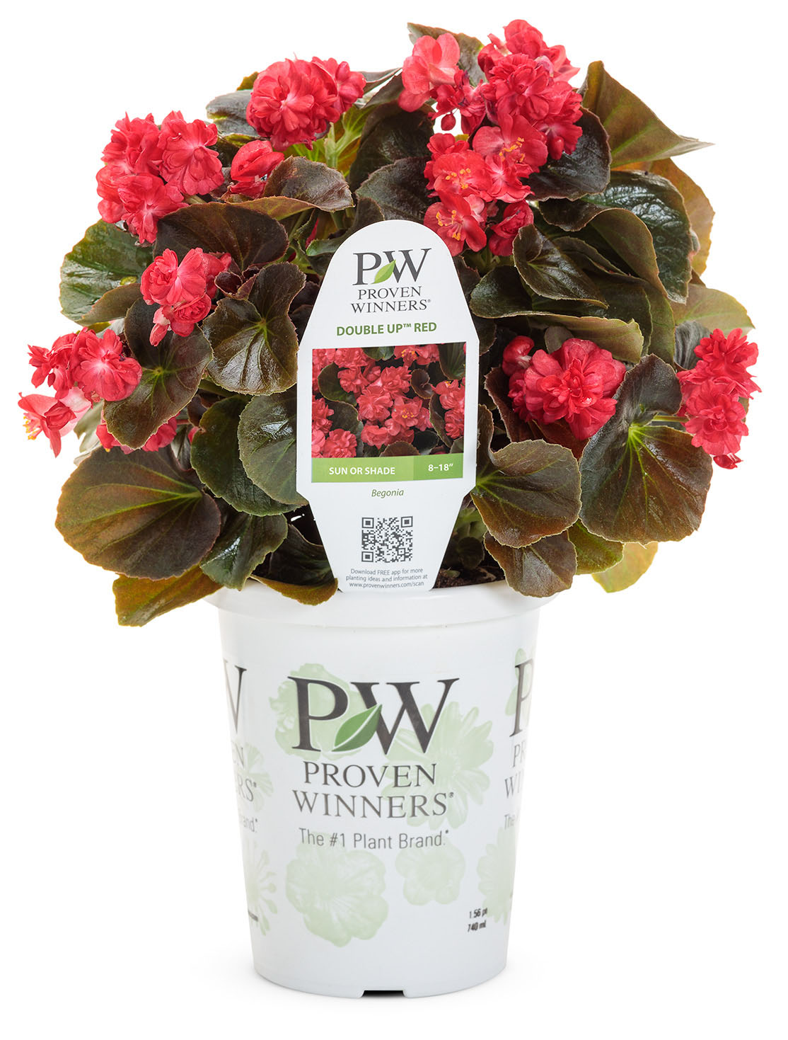
Double Up™ Red

Slide 14
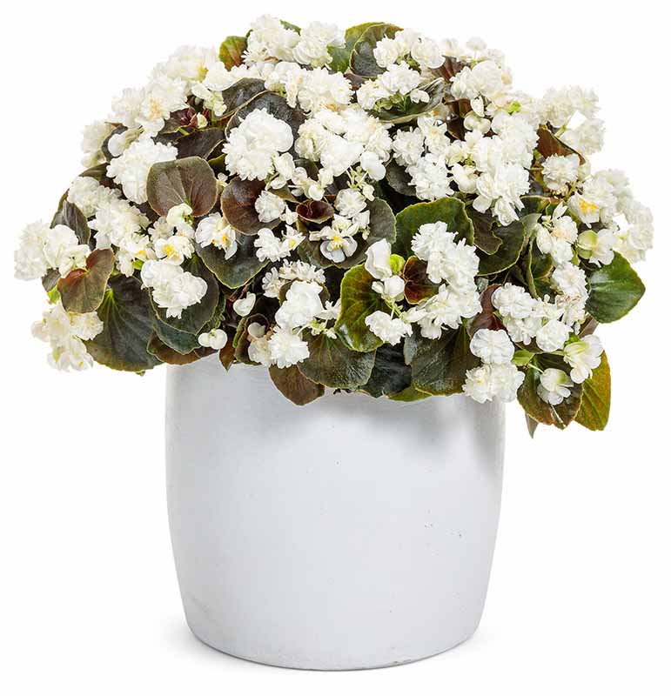
Double Up™ White
Begonia
WHAT’S NEW
This new vegetative wax begonia makes an outstanding 4” crop in production; blooms early and goes long. Superb contrast between dark foliage and double white flowers.
Self-cleaning flowers reduce the incidence of botrytis
Daylength neutral; can be produced any time of year
Grow in 4.25 Grande™ containers, monocultures and landscapes
8-18” height; 8-14” spread
Sun or shade
Vigor 2

Slide 15
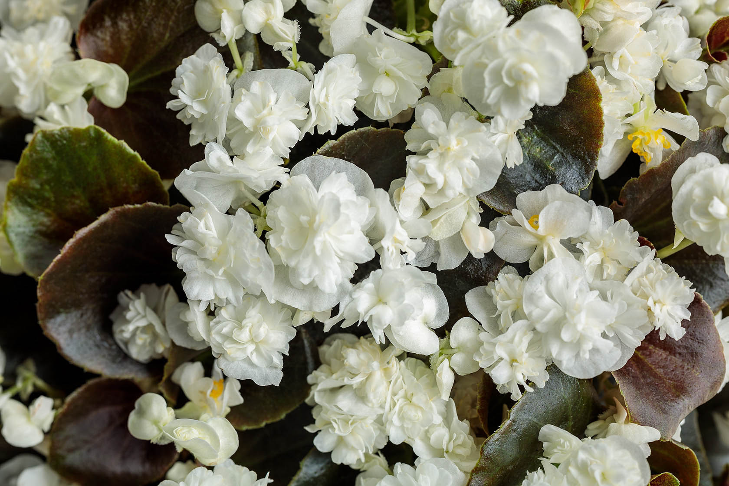
Double Up™ White

Slide 16
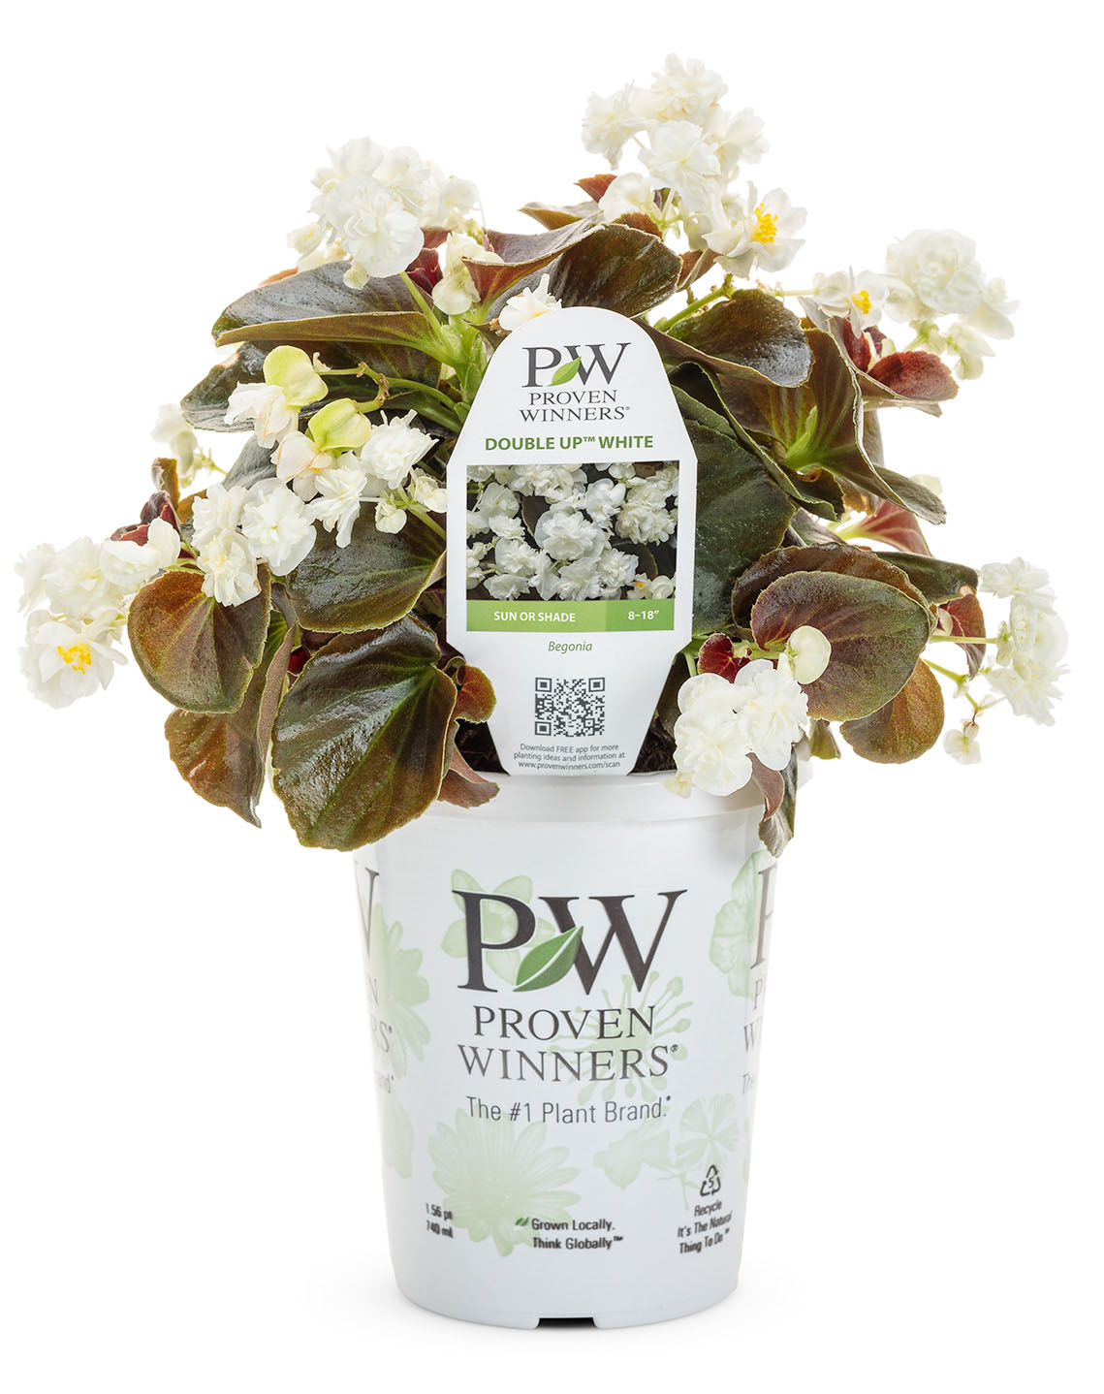
Double Up™ White

Slide 17
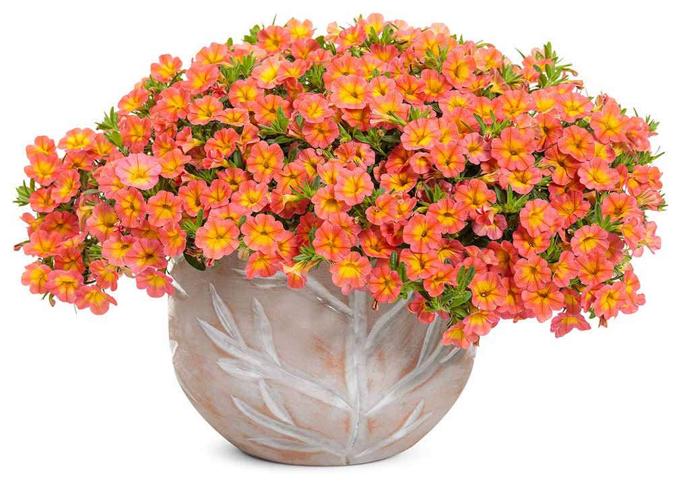
Superbells® Coral Sun
Calibrachoa
WHAT’S NEW
This tropical coral and sunny yellow bicolor is easy to mix with other sun-loving plants in recipes. A beautifully mounded habit blanketed in color makes it irresistible at retail.
Early to bloom
Screened for Thielaviopsis resistance
Grow in 4.25 Grande™ containers, hanging baskets, window boxes, recipes and monocultures
6-12” height; 12-24” spread
Part sun to sun
Vigor 2

Slide 18
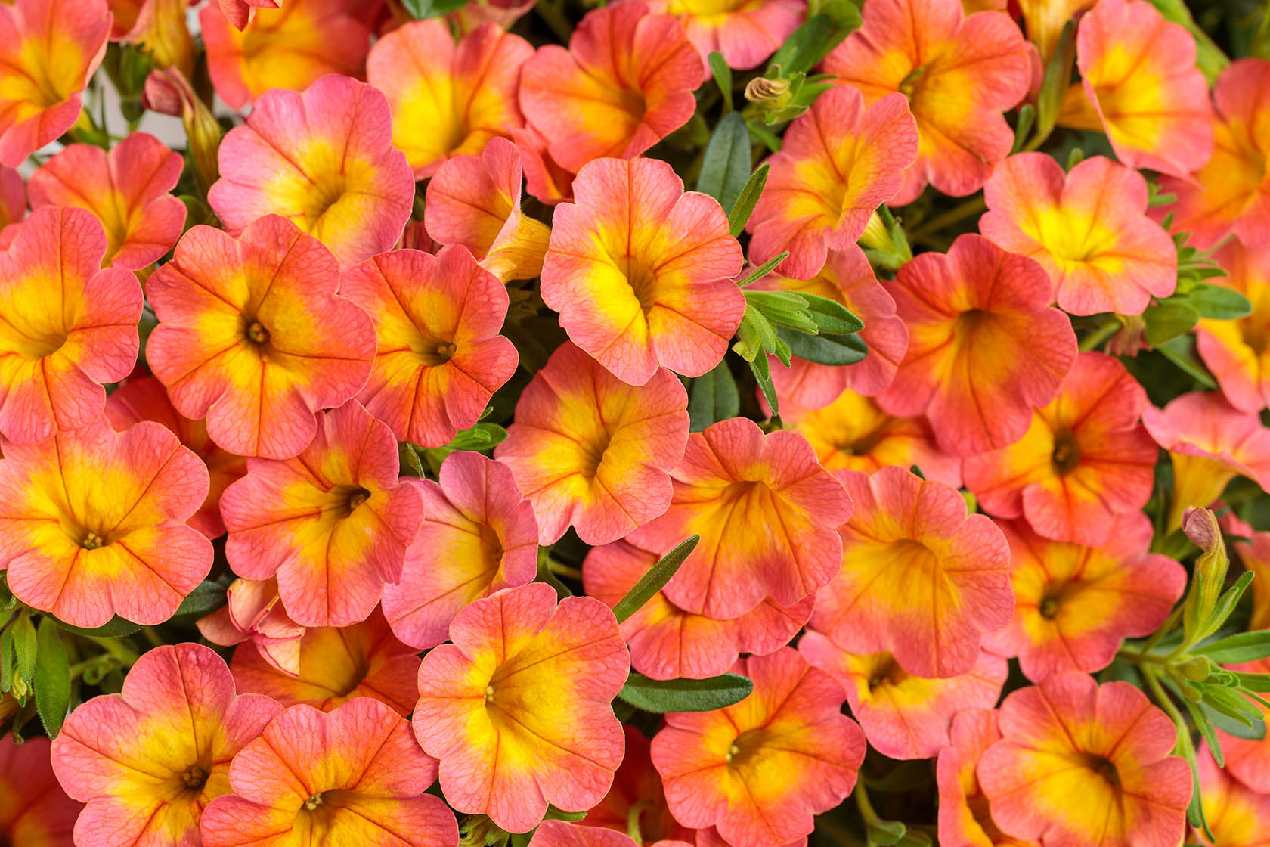
Superbells® Coral Sun

Slide 19
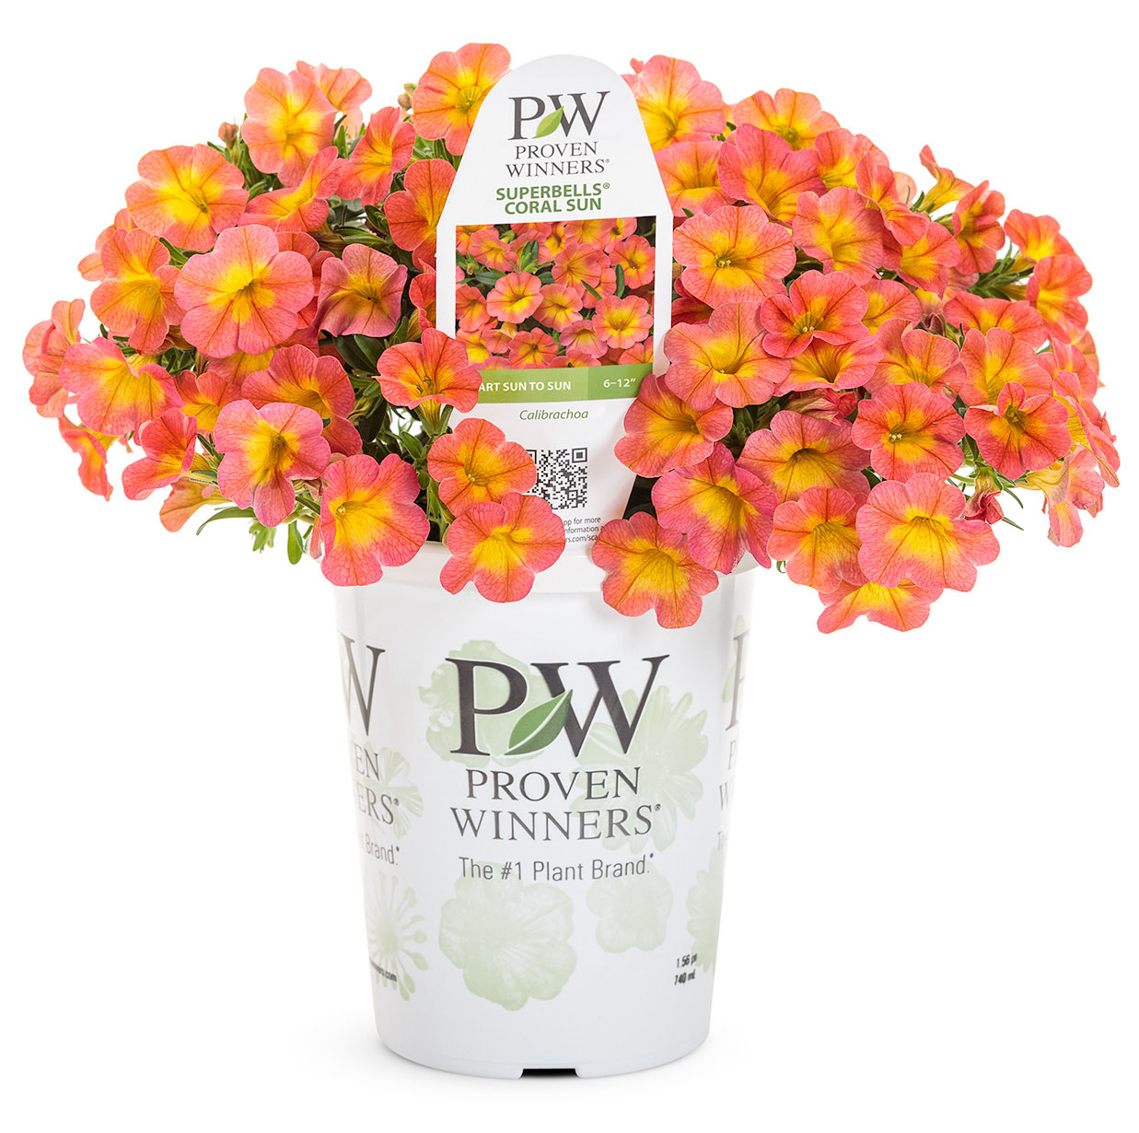
Superbells® Coral Sun

Slide 20
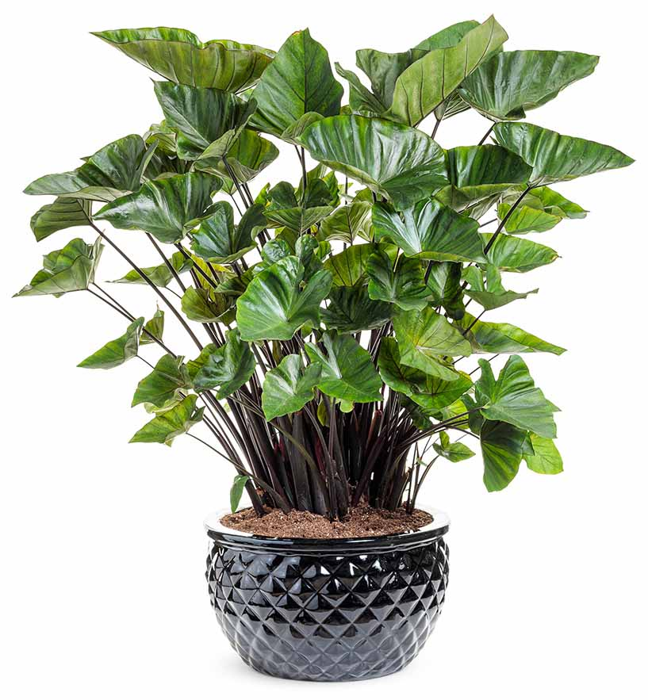
‘Coffee Cups’
Colocasia
WHAT’S NEW
Capitalize on the tropical trend by adding this distinctive Colocasia with dramatically cupped, olive green foliage and mocha accents.
Dynamic “thriller” for large combinations
Grow in 1.0 Royale™ containers, recipes, monocultures and landscapes
36-60” height; 36-60” spread
Part sun to sun
Vigor 3

Slide 21
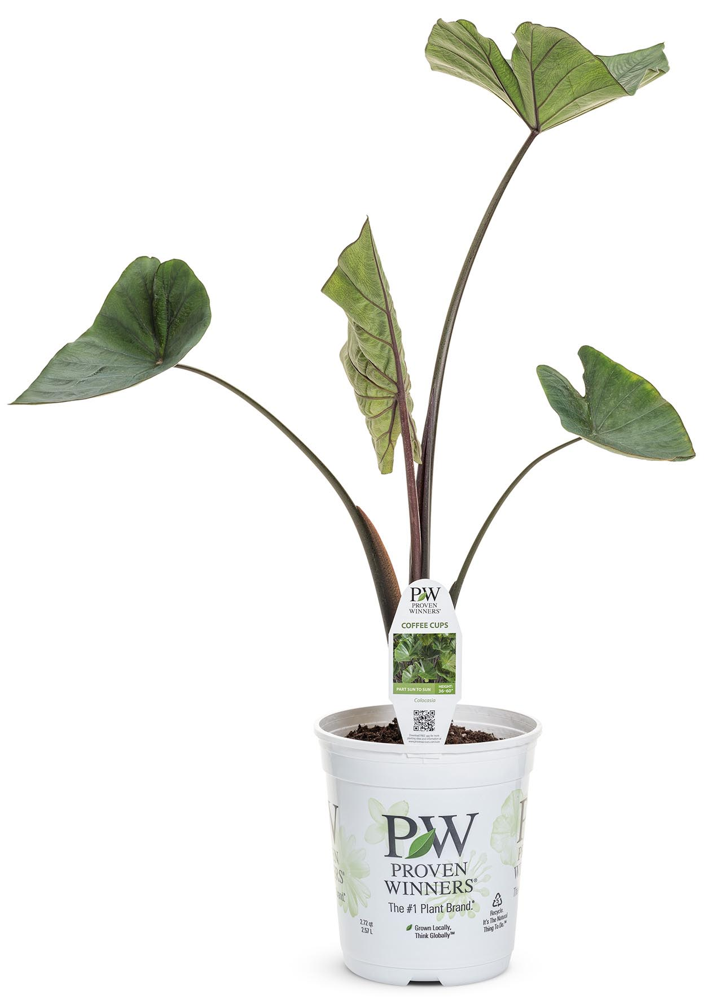
‘Coffee Cups’

Slide 22
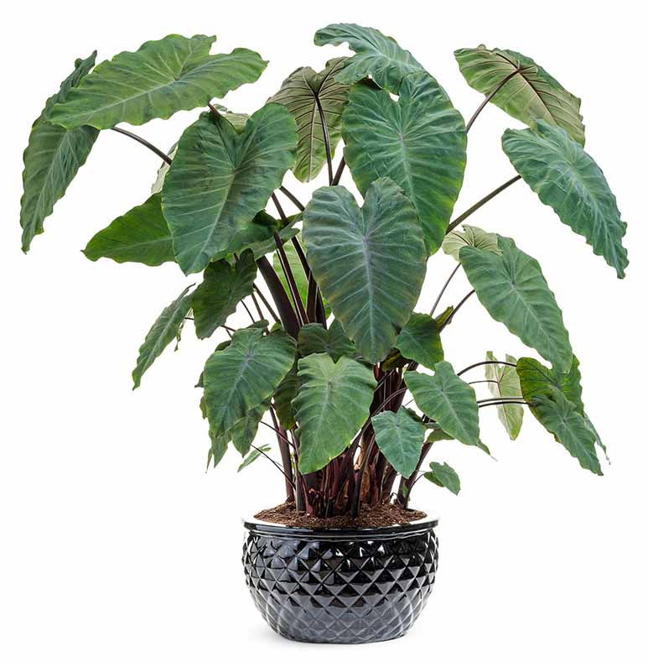
Heart of the Jungle™
Colocasia
WHAT’S NEW
Earn instant tropical appeal by adding this huge heart-leafed, dark green, black-stemmed cultivar to combinations, landscapes and pond plantings.
Dramatic “thriller” for large combinations
Grow in 1.0 Royale™ containers, recipes, monocultures and landscapes
36-60” height; 36-60” spread
Part sun to sun
Vigor 3

Slide 23
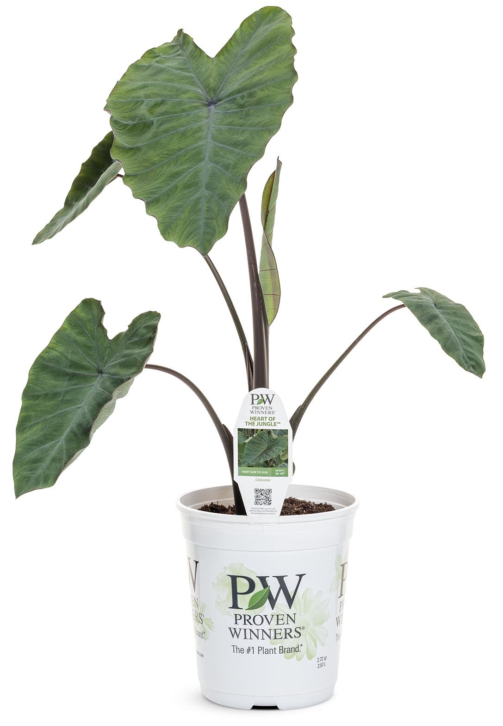
Heart of the Jungle™

Slide 24
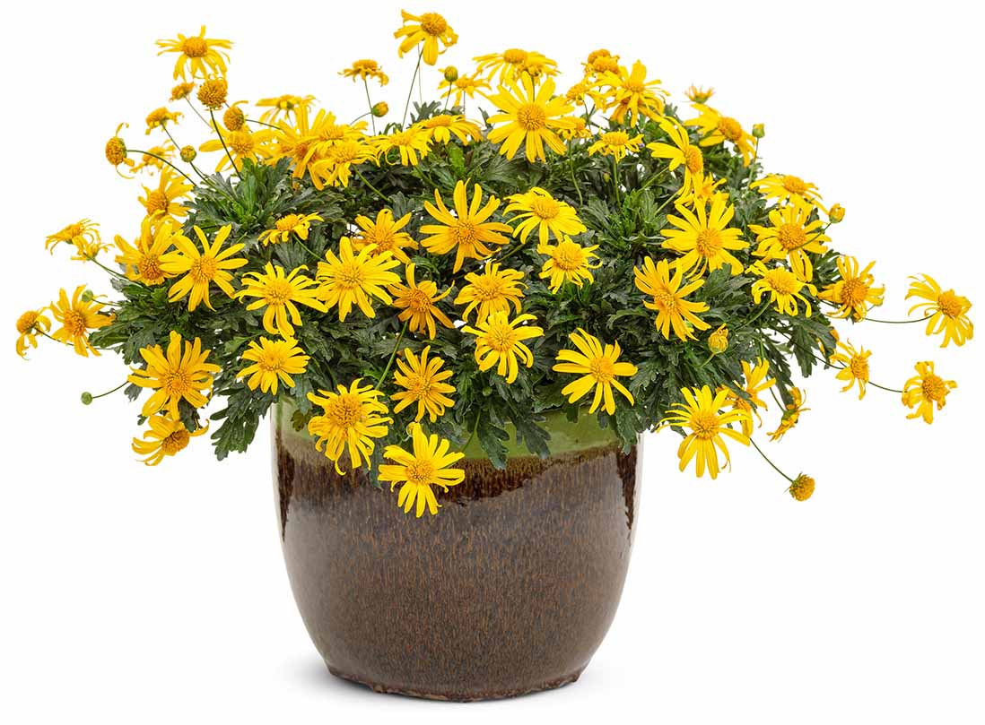
High Noon™
Euryops
WHAT’S NEW
A new genus for Proven Winners. We’ve taken Euryops and refined it for today’s growers by making it more colorful, more compact, and easier to get into flower for spring in the North.
Large, prolific, sunny yellow blossoms
Better branched, denser habit
Grow in 4.25 Grande™ containers, hanging baskets, recipes and monocultures
10-14” height; 12-18” spread
Part sun to sun
Vigor 2

Slide 25
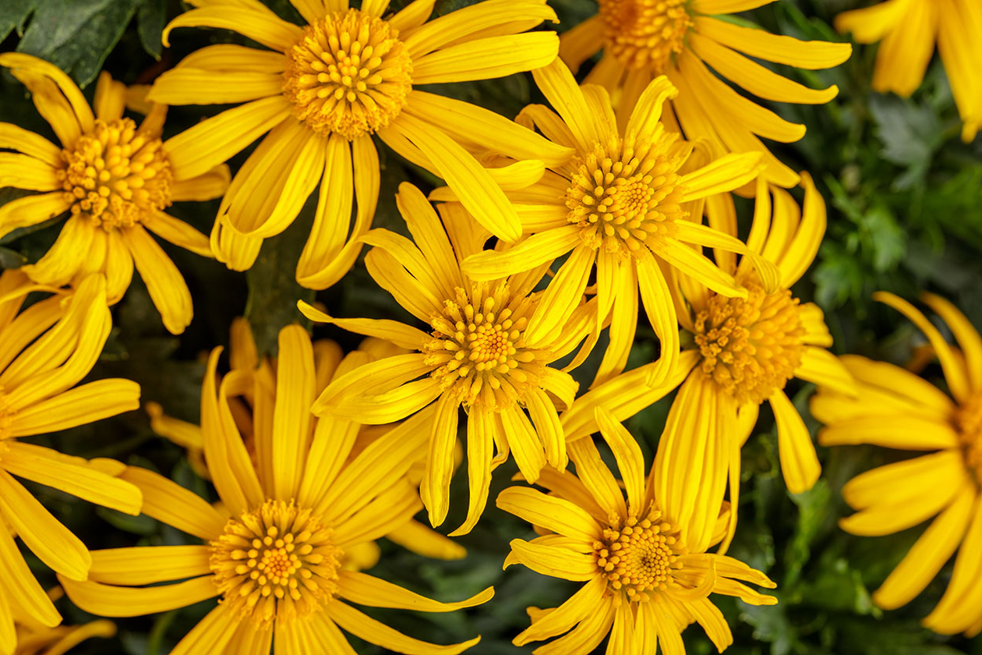
High Noon™

Slide 26
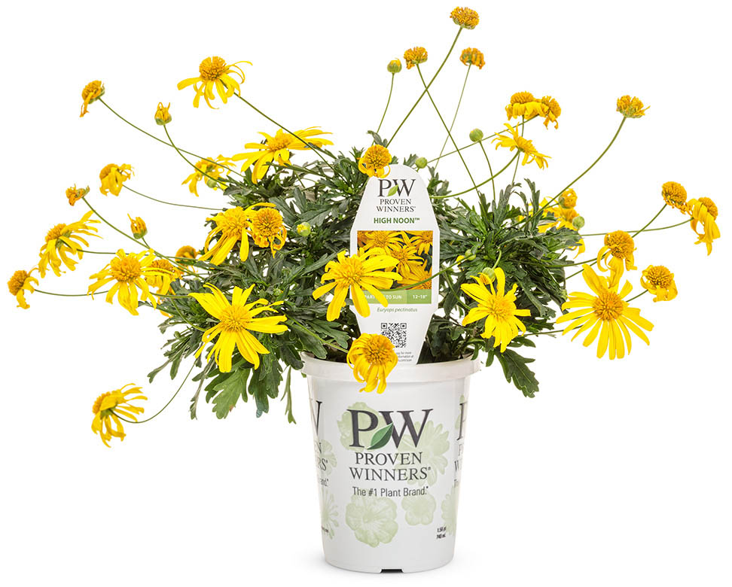
High Noon™

Slide 27
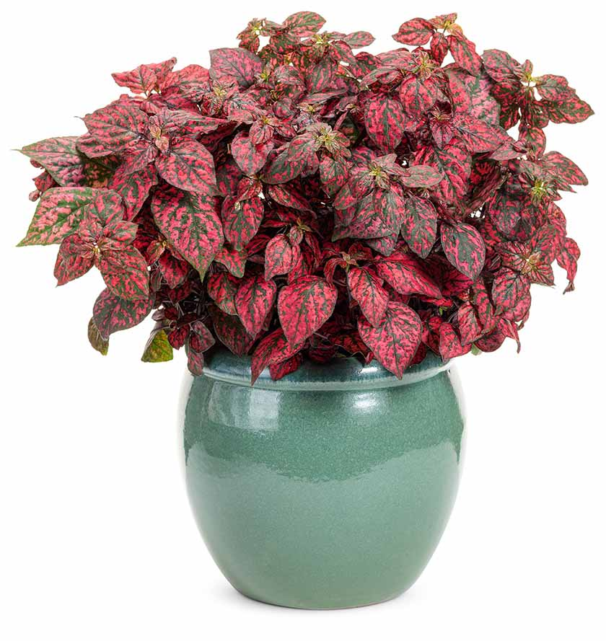
Hippo® Red (Imp)
Hypoestes
WHAT’S NEW
We’ve improved upon this super-sized, vegetative variety by giving it brighter red color that absolutely glows in the shade. Use it like a red coleus with fun polka-dotted foliage.
Heat and humidity tolerant
Selected against flowering; best grown under long days
Grow in 4.25 Grande™ containers, recipes, monocultures and landscapes
16-22" height; 8-14" spread
Part shade to shade
Vigor 2

Slide 28
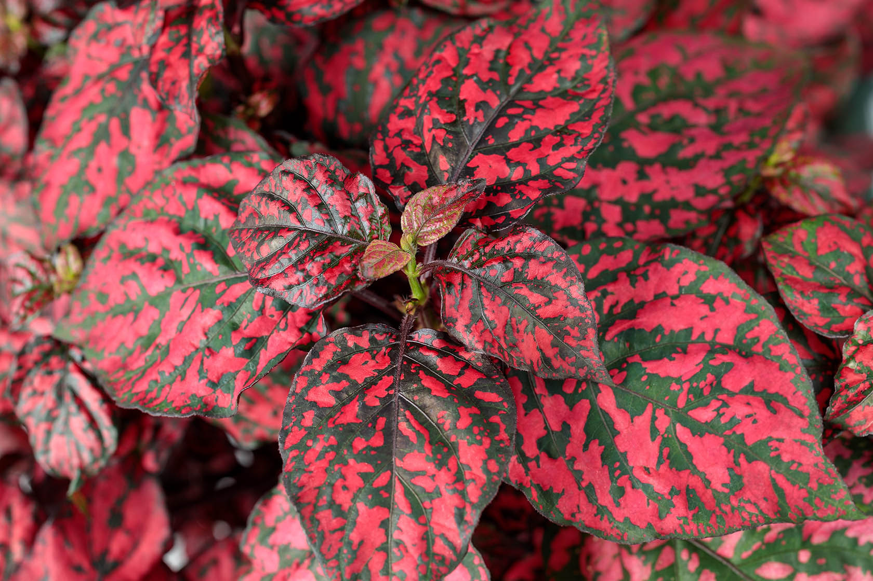
Hippo® Red (Imp)

Slide 29
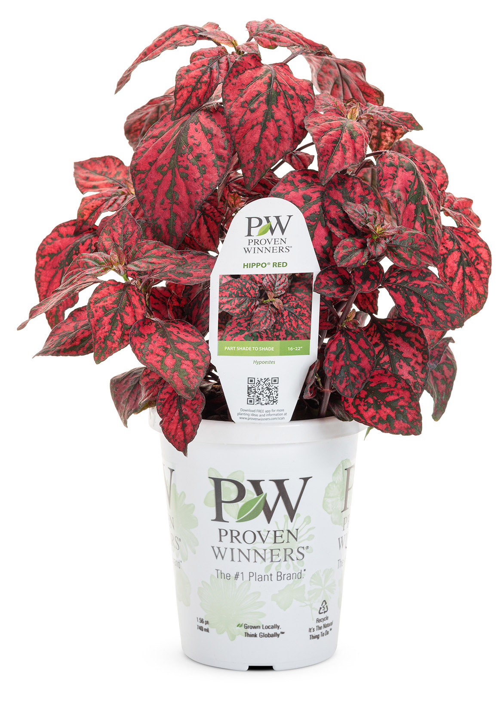
Hippo® Red (Imp)

Slide 30
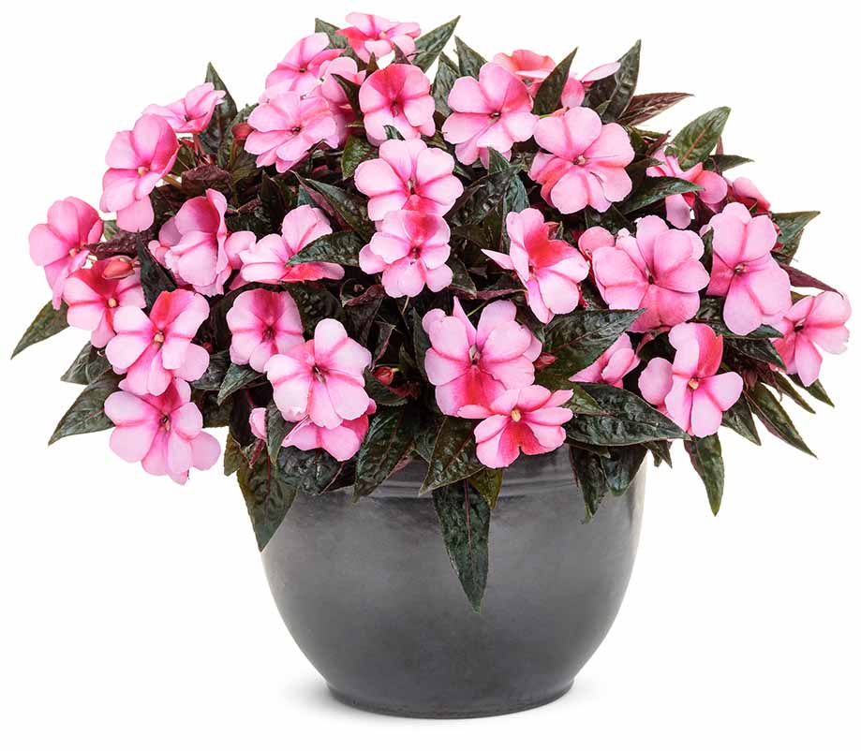
Infinity® Blushing Crimson (Imp)
Impatiens
WHAT’S NEW
An easy Grande crop for growers to produce for their shade assortment. Huge, red and pink bicolor flowers cover this more vigorous, compact selection.
Heat and humidity tolerant
Attractive container presentation
Grow in 4.25 Grande™ containers, recipes, monocultures and landscapes
10-14" height; 6-12" spread
Part shade to shade
Vigor 1

Slide 31
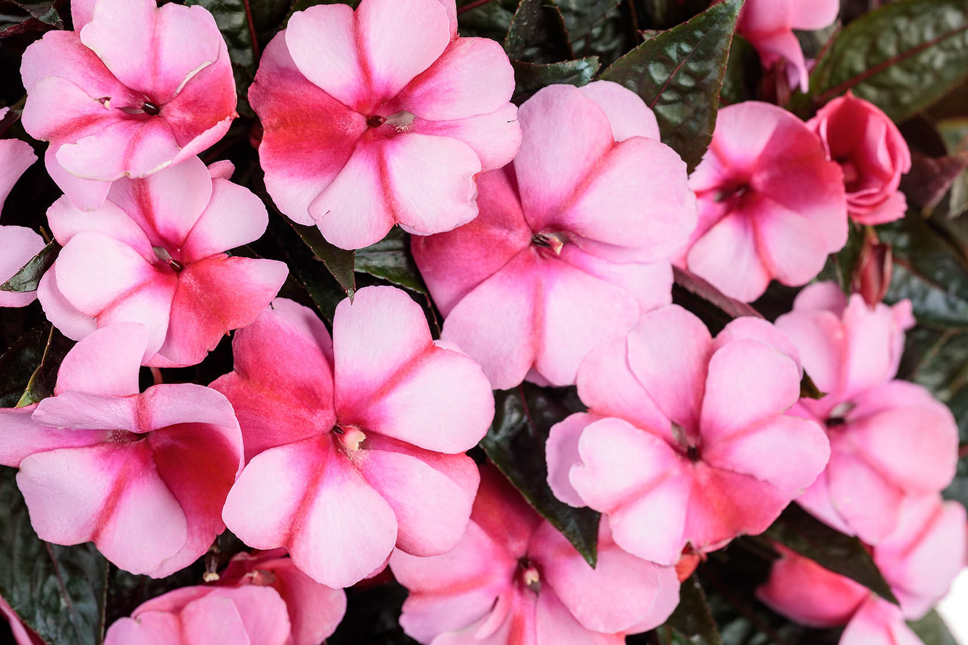
Infinity® Blushing Crimson (Imp)

Slide 32
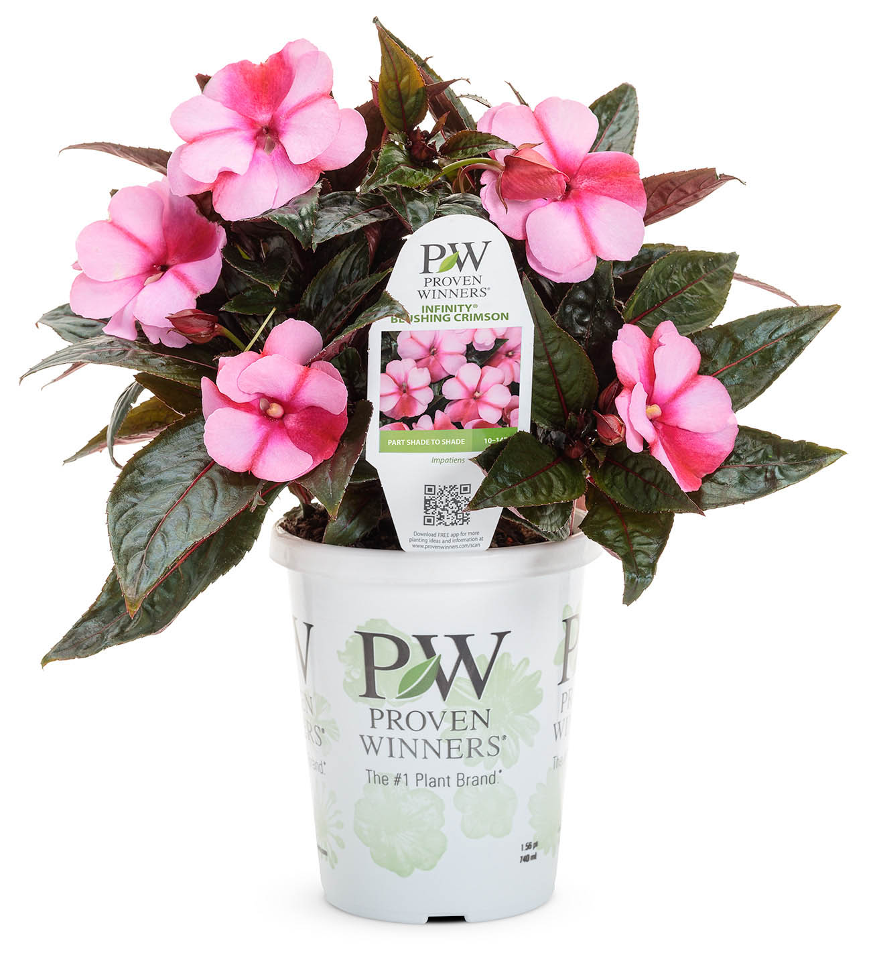
Infinity® Blushing Crimson (Imp)

Slide 33
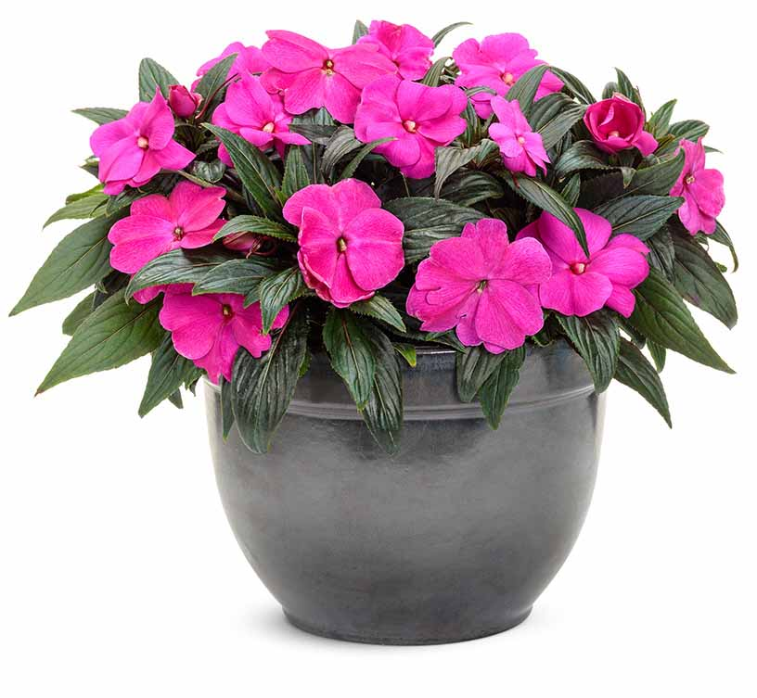
Infinity® Light Purple (Imp)
Impatiens
WHAT’S NEW
An easy Grande crop for growers to produce for their shade assortment. Huge, vibrant purple flowers cover this more vigorous, compact selection.
Heat and humidity tolerant
Attractive container presentation
Grow in 4.25 Grande™ containers, recipes, monocultures and landscapes
10-14" height; 6-12" spread
Part shade to shade
Vigor 1

Slide 34
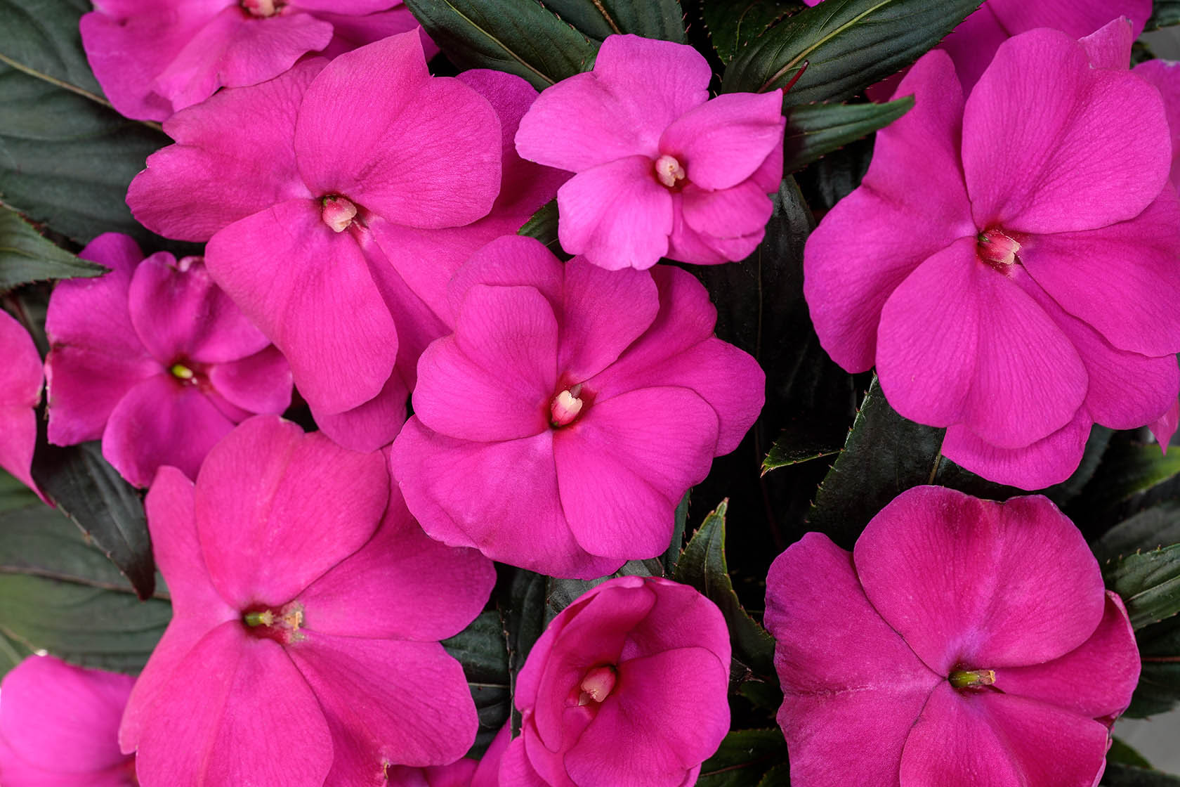
Infinity® Light Purple (Imp)

Slide 35
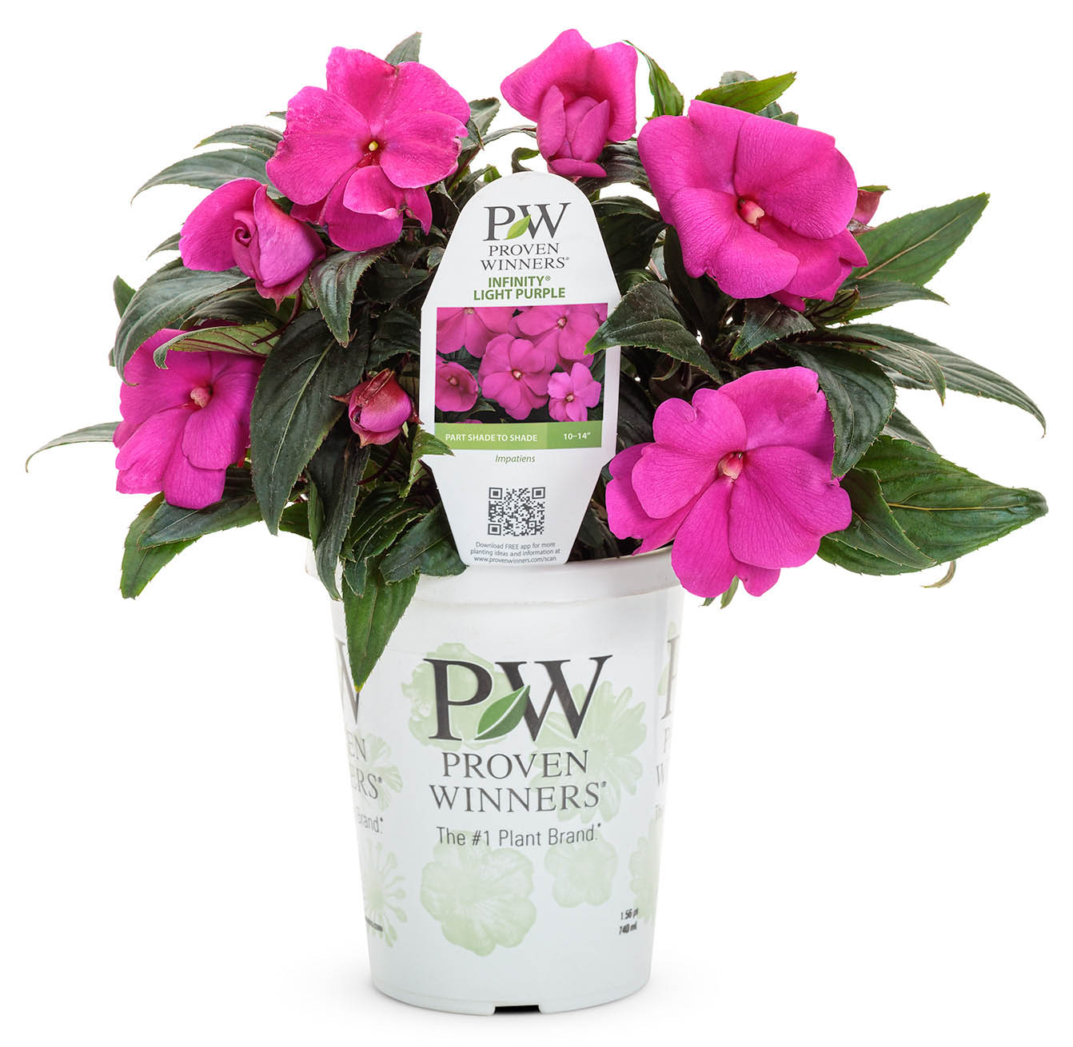
Infinity® Light Purple (Imp)

Slide 36
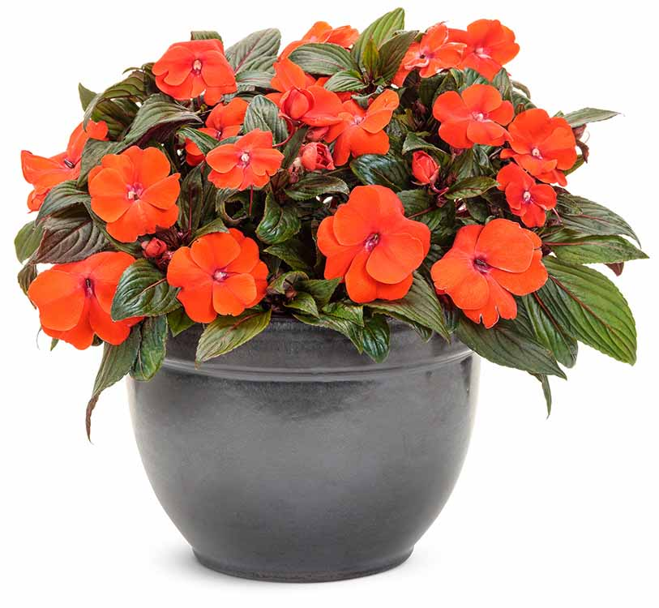
Infinity® Orange (Imp)
Impatiens
WHAT’S NEW
An easy Grande crop for growers to produce for their shade assortment. Huge, fiery orange flowers cover this more vigorous, compact selection.
Heat and humidity tolerant
Attractive container presentation
Grow in 4.25 Grande™ containers, recipes, monocultures and landscapes
10-14" height; 6-12" spread
Part shade to shade
Vigor 1

Slide 37
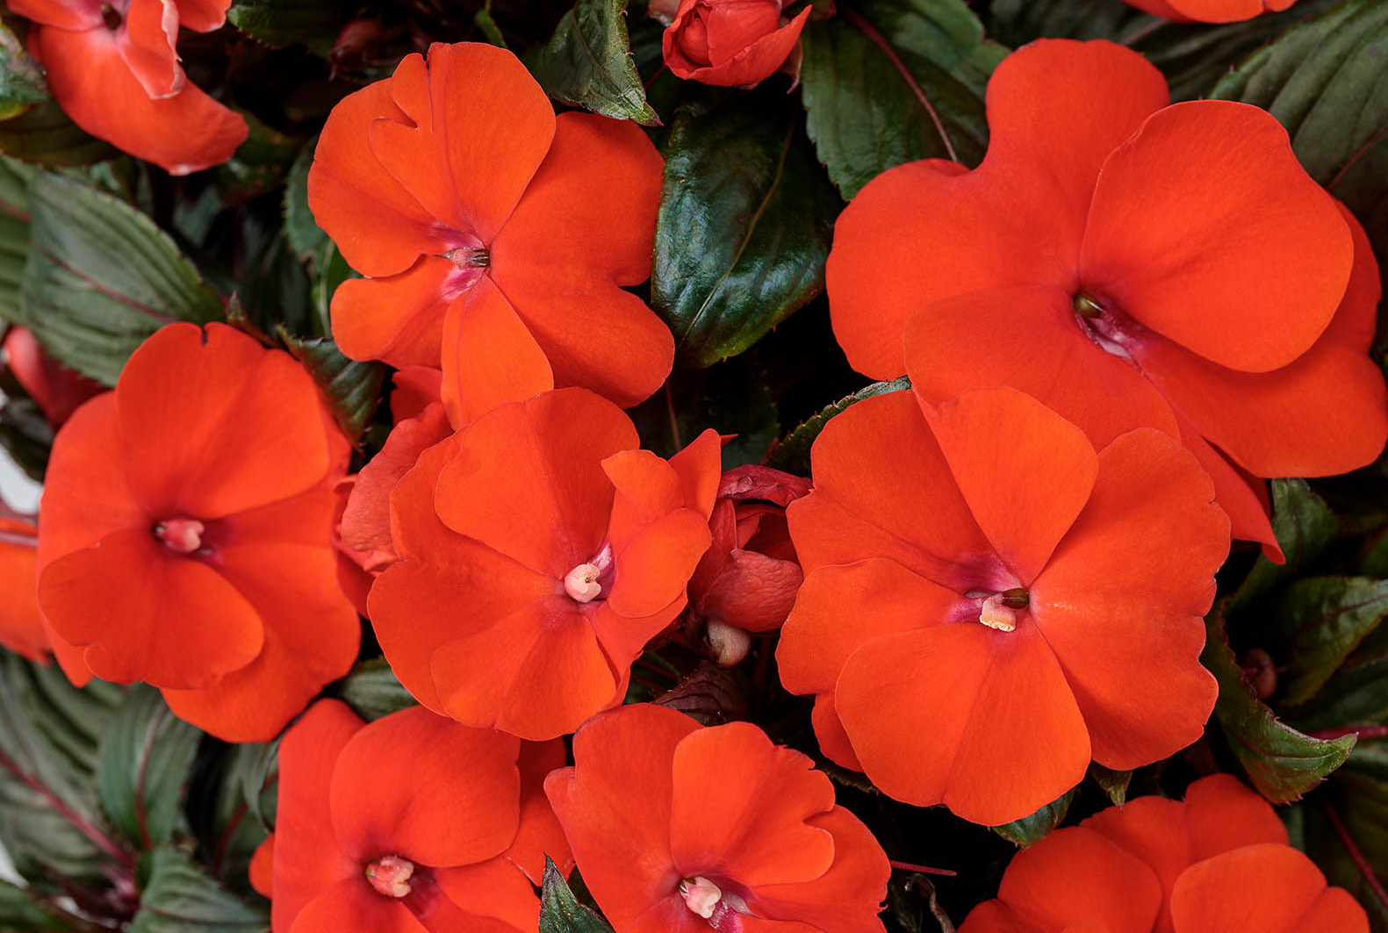
Infinity® Orange (Imp)

Slide 38
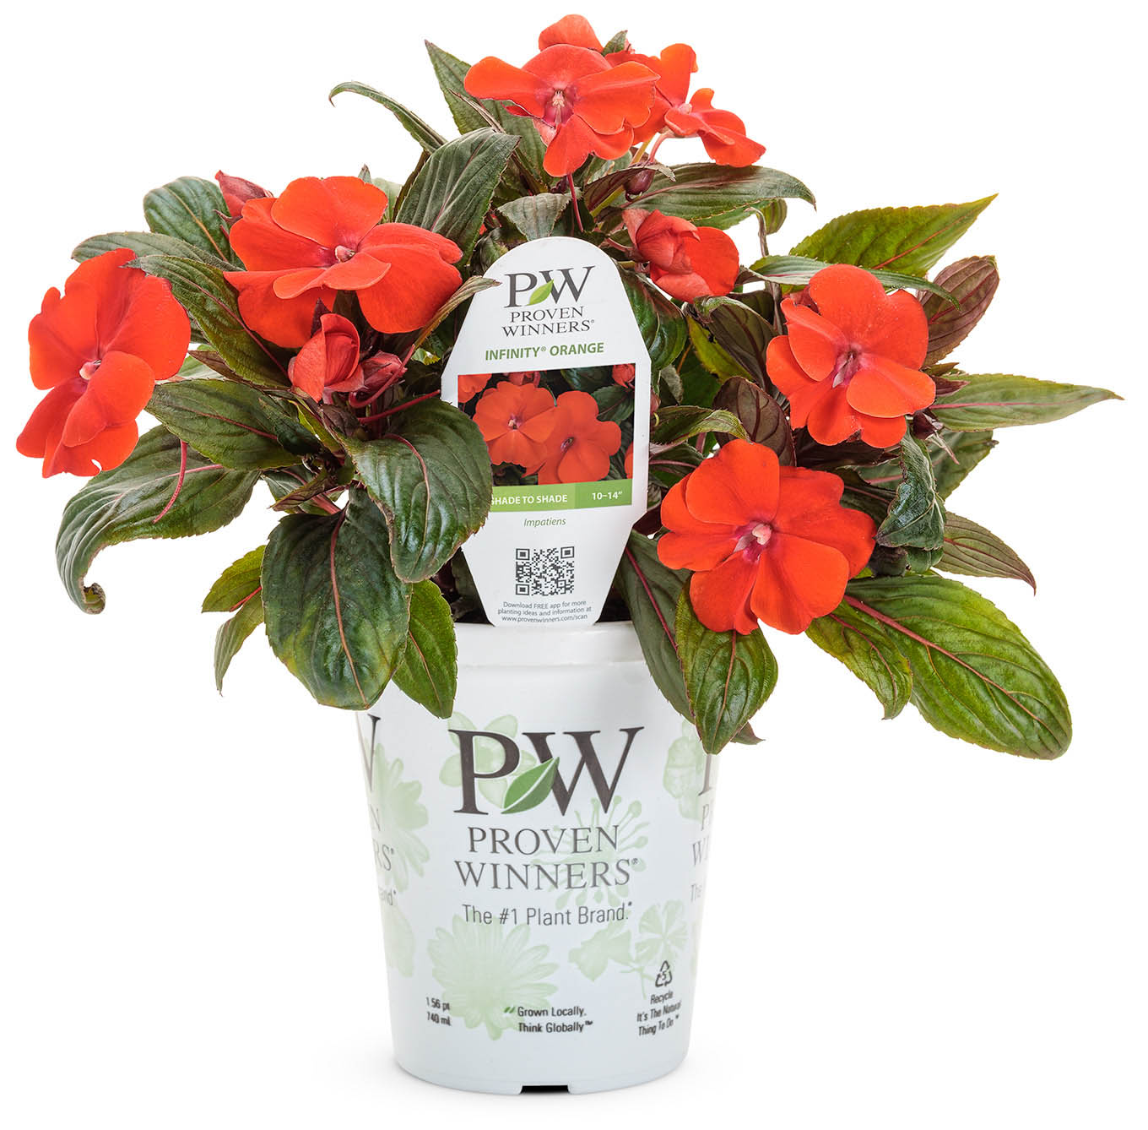
Infinity® Orange (Imp)

Slide 39
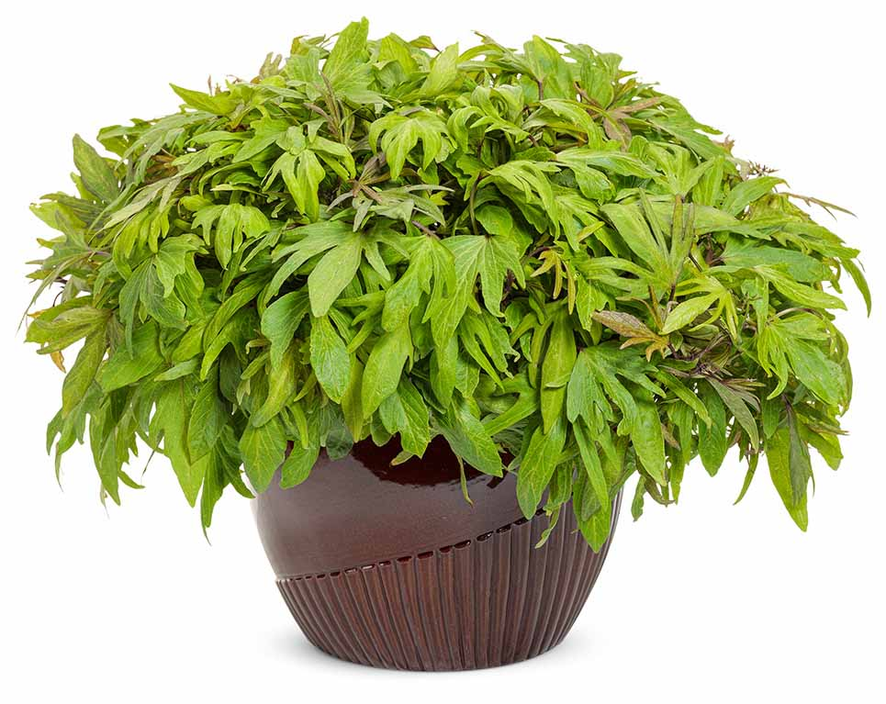
Sweet Caroline Medusa™ Green
Ipomoea
WHAT’S NEW
A first to market, exclusive new foliage form for Ipomoea. Distinctive palm-shaped, thick, chartreuse leaves on tight internodes form a compact, mounded to slightly trailing plant.
Won’t flag or fade in the heat
Well-behaved in recipes
Grow in 4.25 Grande™ containers, hanging baskets, recipes and landscapes
6-12" height; 18-24" spread
Part sun to sun
Vigor 3

Slide 40
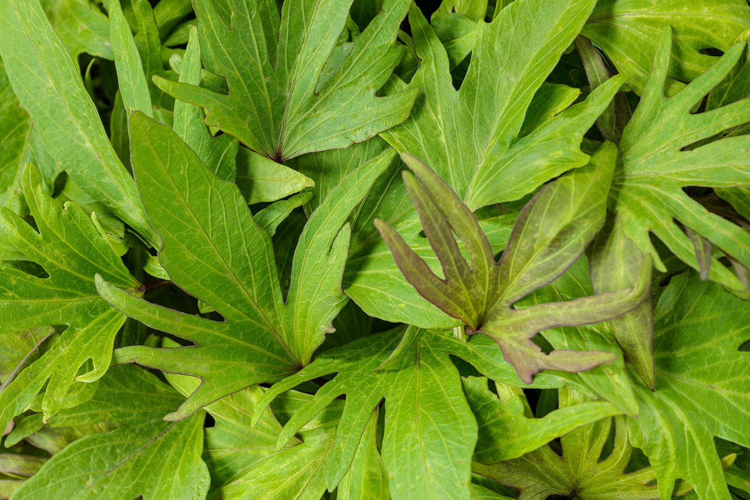
Sweet Caroline Medusa™ Green

Slide 41
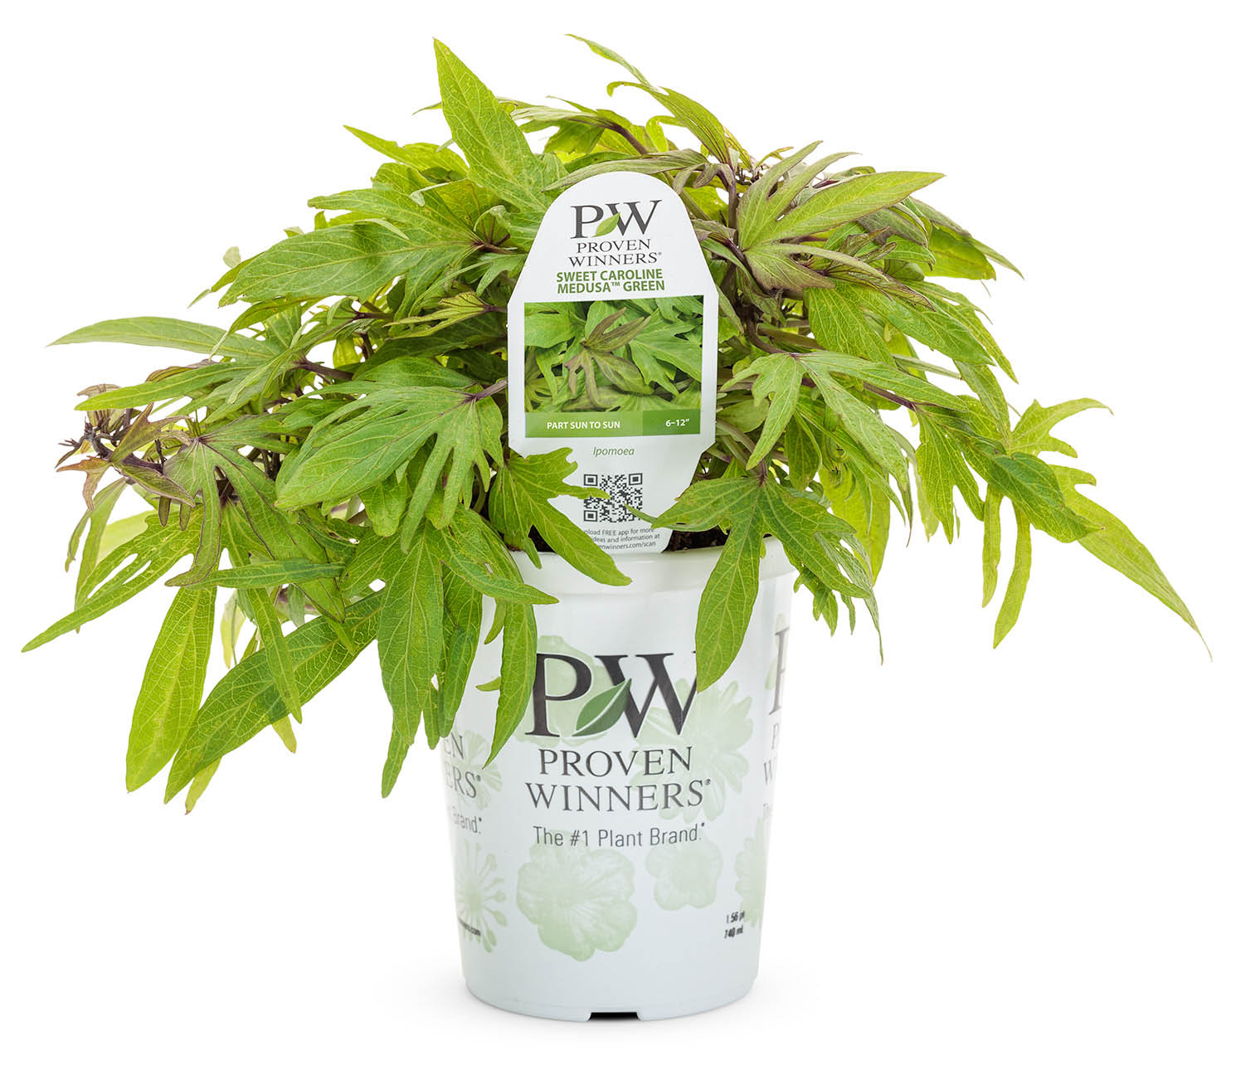
Sweet Caroline Medusa™ Green

Slide 42
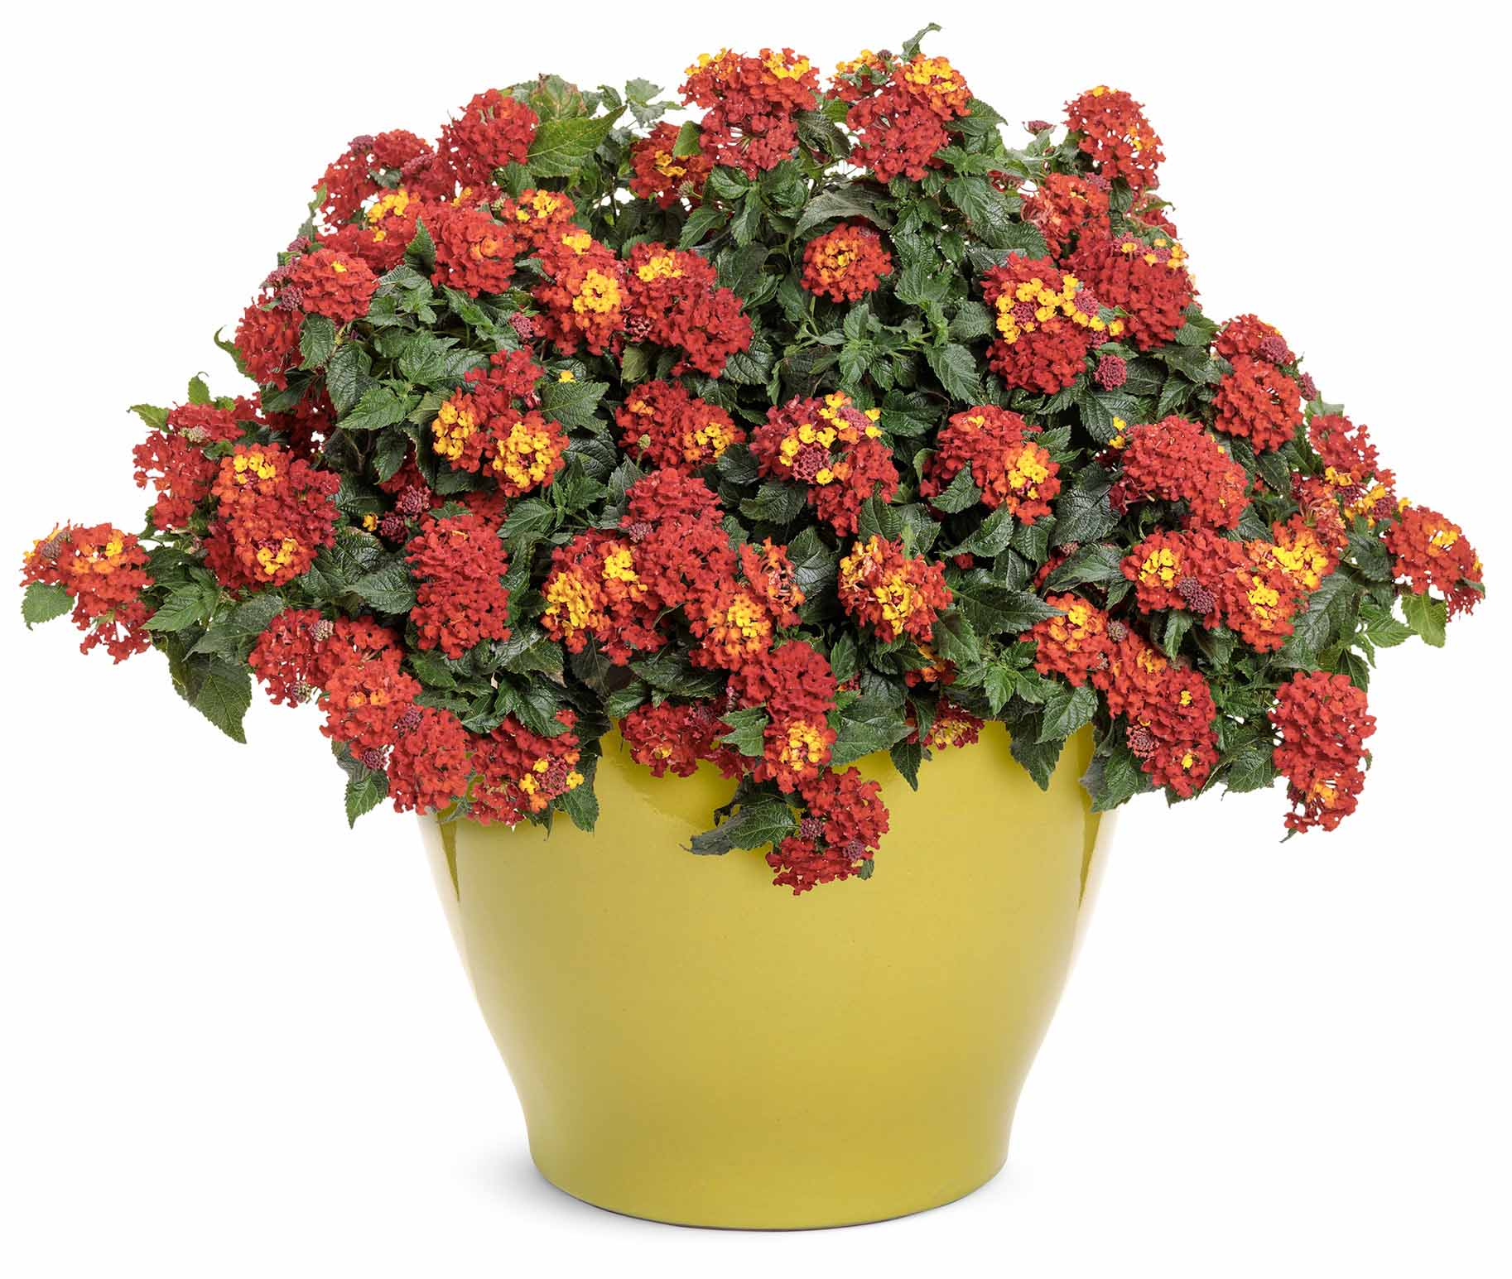
Luscious® Royale Red Zone™
Lantana
WHAT’S NEW
A certified sterile selection; non-invasive. Large clusters of fragrant, pollinator-friendly blossoms emerge red and orange bicolor, then transition to pure glowing red on compact, upright plants.
Heat and drought tolerant
Well-branched plants present well in containers
Grow in 4.25 Grande™ containers, recipes, monocultures and landscapes
12-26" height; 12-24" spread
Full sun
Vigor 2

Slide 43
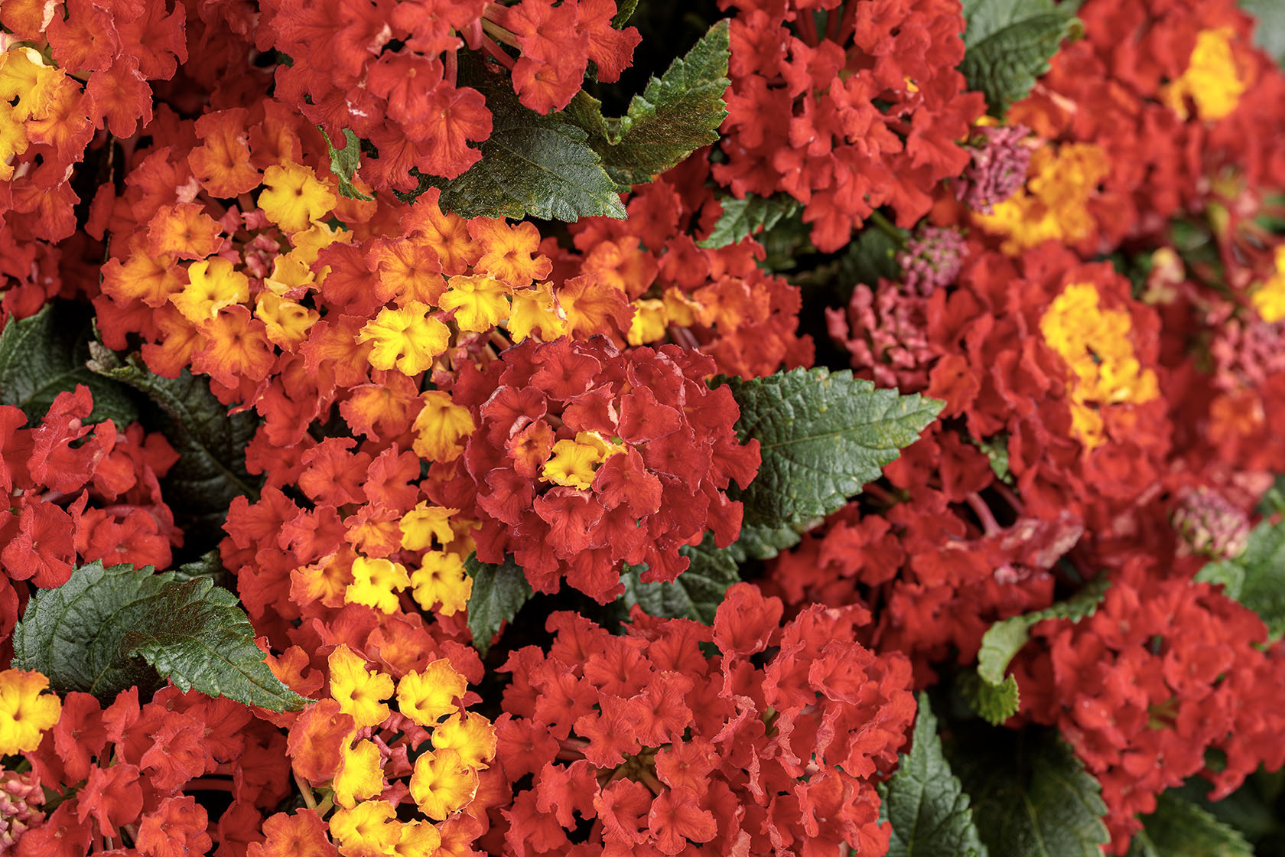
Luscious® Royale Red Zone™

Slide 44
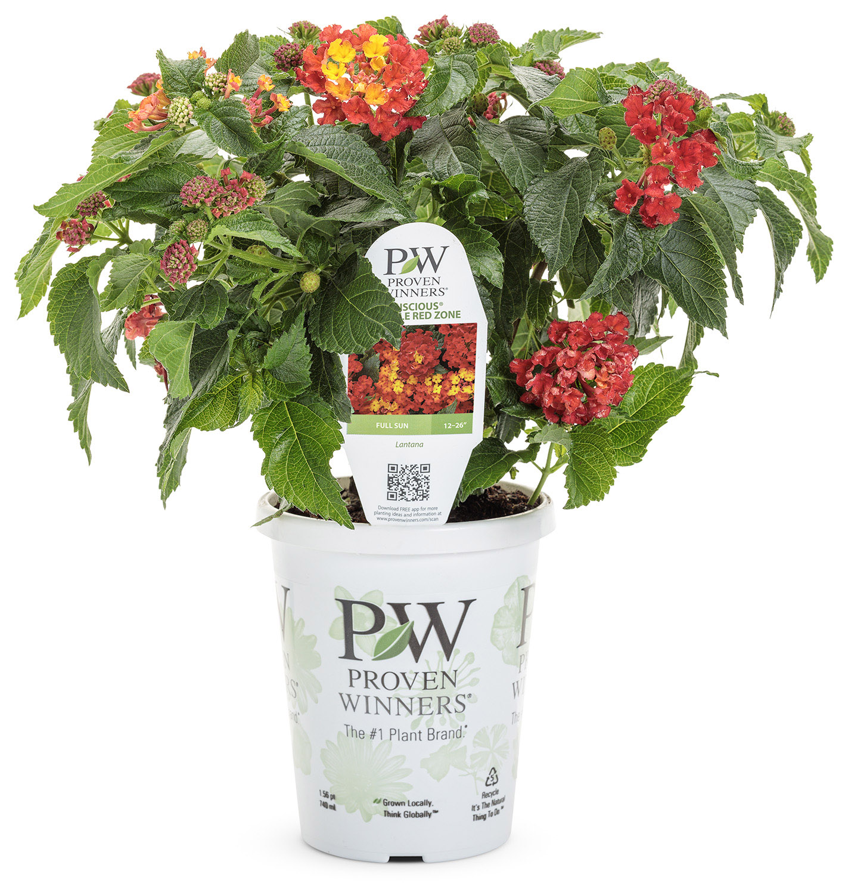
Luscious® Royale Red Zone™

Slide 45
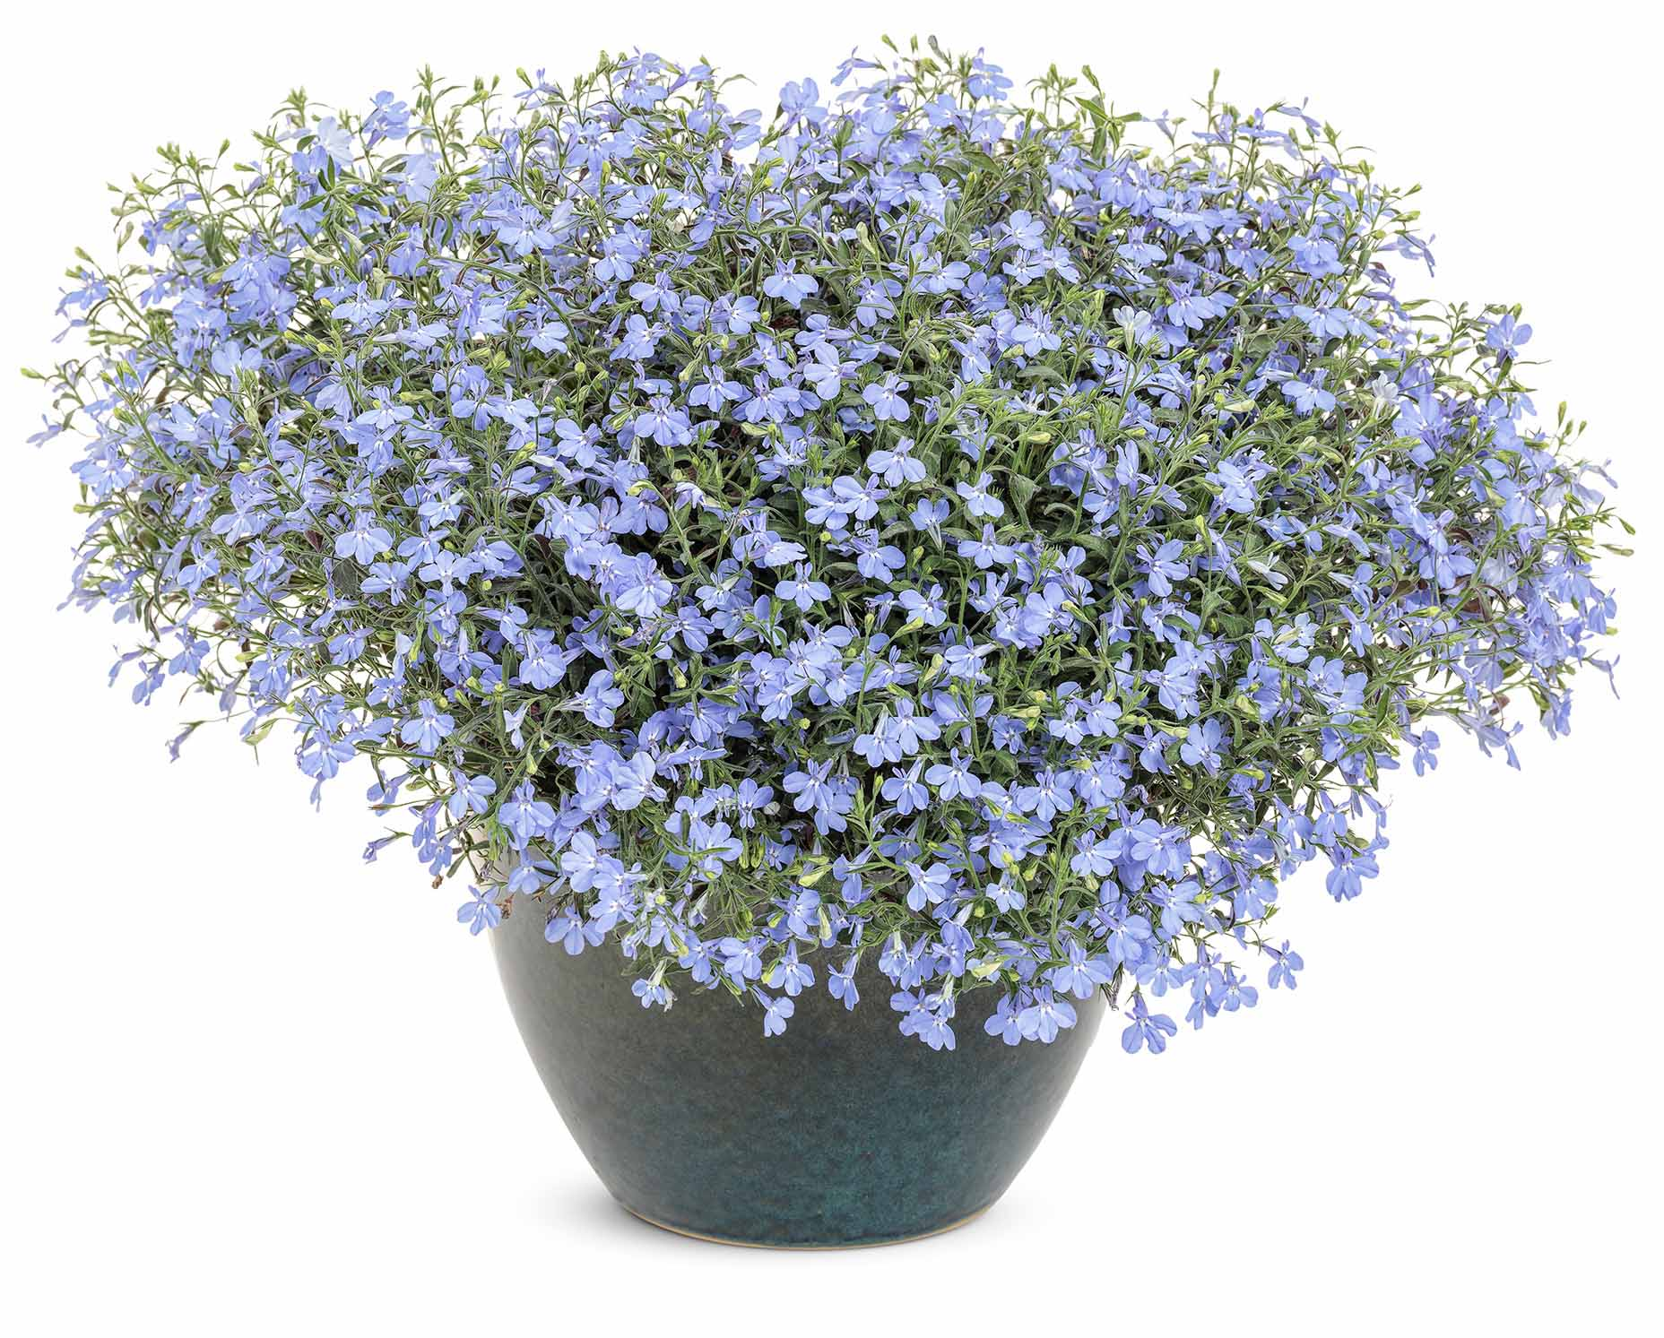
Laguna® Sky Blue (Imp)
Lobelia
WHAT’S NEW
This upgrade to our top-selling Lobelia features an improved summer performance, larger flowers, and true sky blue color that holds a month longer through the summer heat.
Essential component for recipes
Full, semi-upright habit
Grow in 4.25 Grande™ containers, hanging baskets, window boxes and landscapes
6-12” height; 12-24” spread
Part sun to sun
Vigor 2

Slide 46
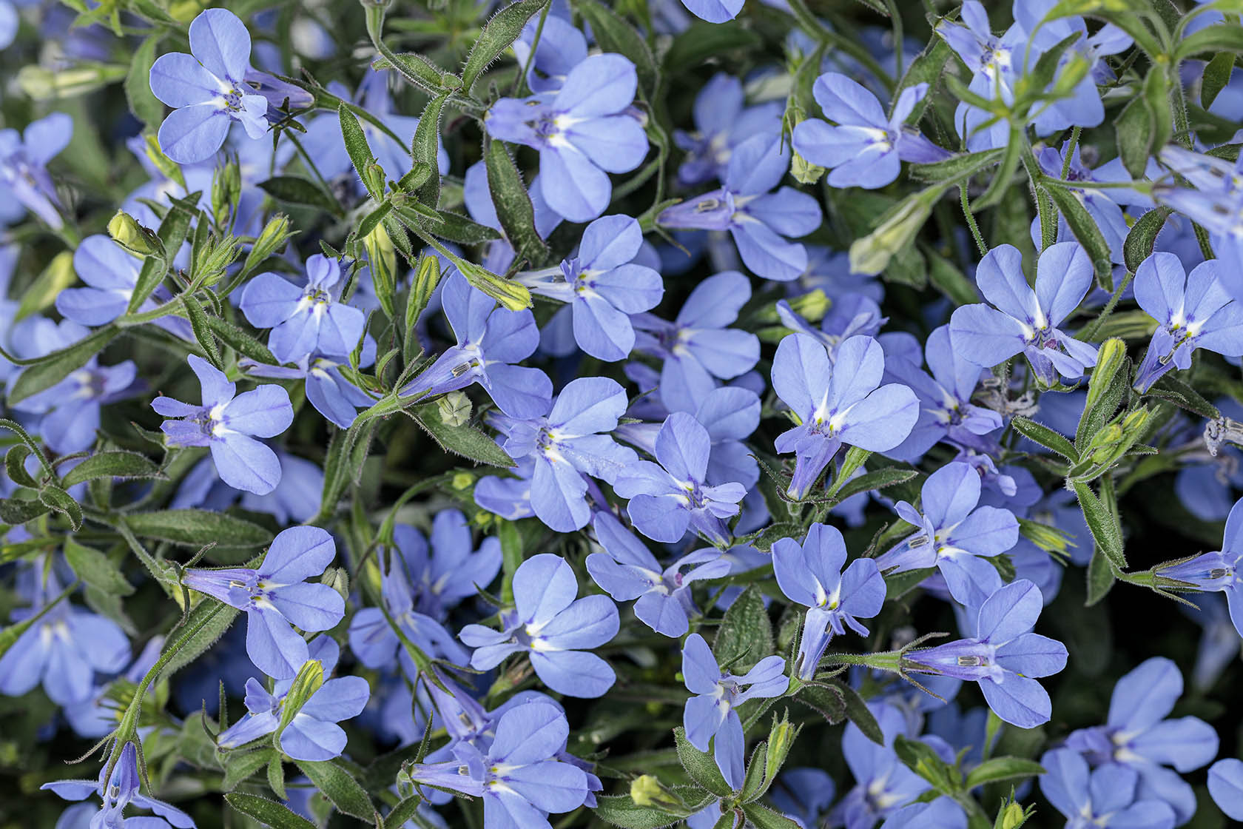
Laguna® Sky Blue (Imp)

Slide 47
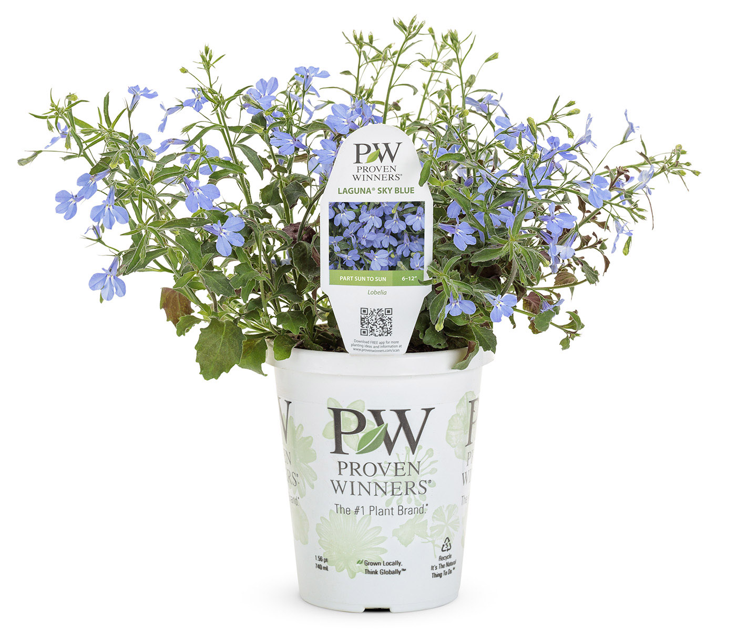
Laguna® Sky Blue (Imp)

Slide 48
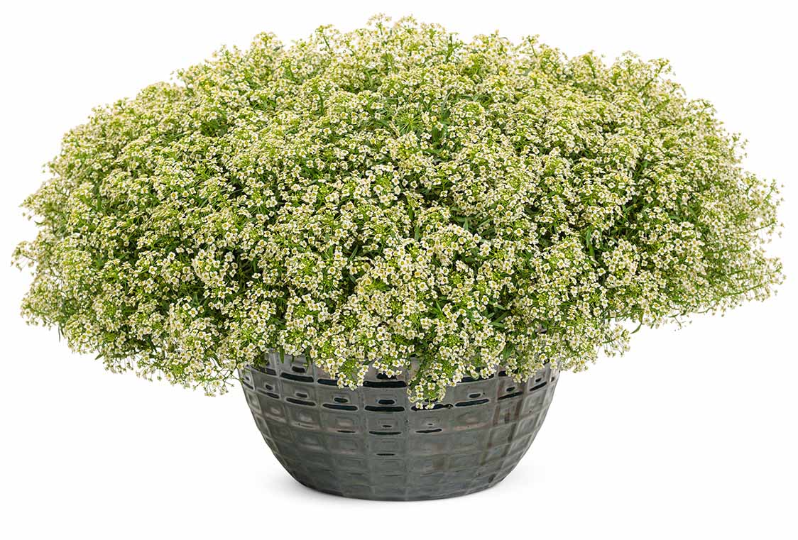
Moonlight Knight™
Lobularia
WHAT’S NEW
A welcome color expansion for our vegetative Lobularia line. Soft yellow blossoms completely blanket the well-branched plants all season, powering through the heat of summer.
Highly attractive to pollinators
Grow in 4.25 Grande™ containers, hanging baskets, window boxes, recipes and landscapes
8-12” height; 18-24” spread
Part sun to sun
Vigor 3

Slide 49
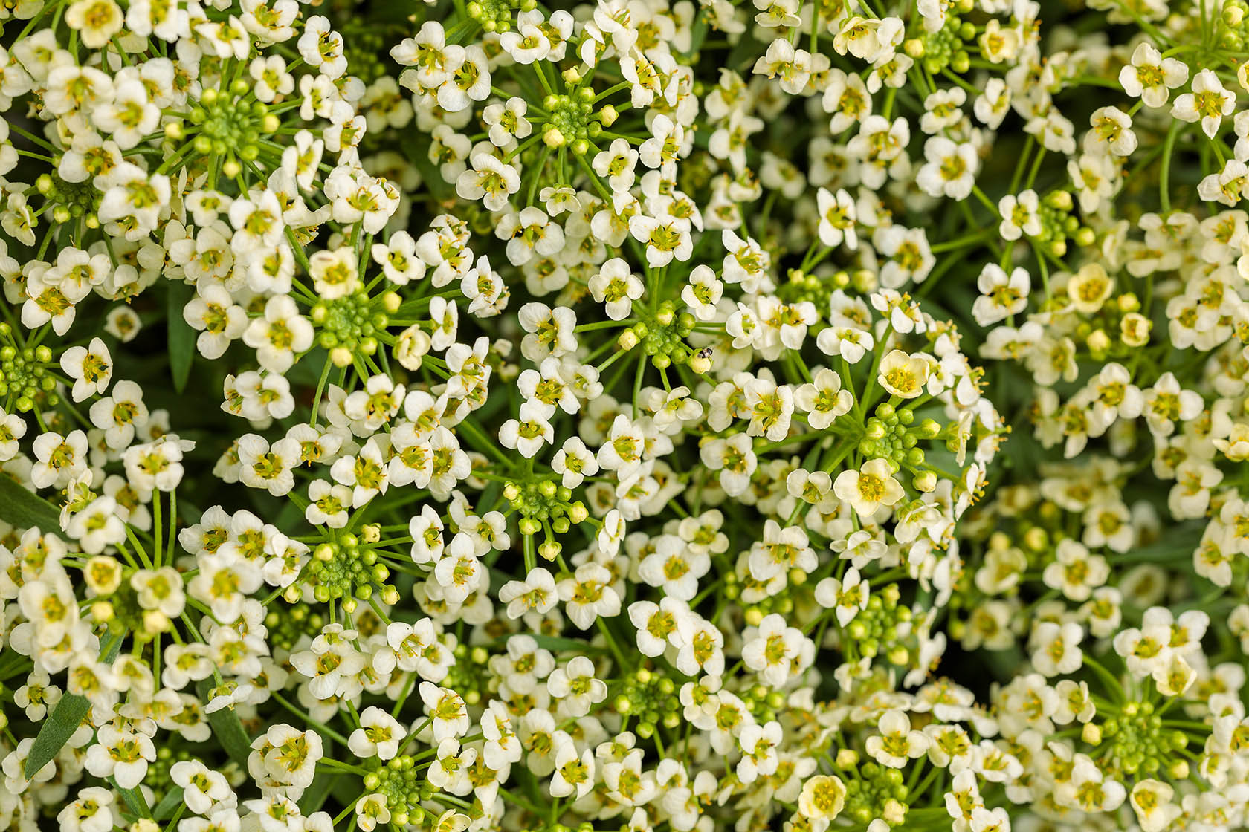
Moonlight Knight™

Slide 50
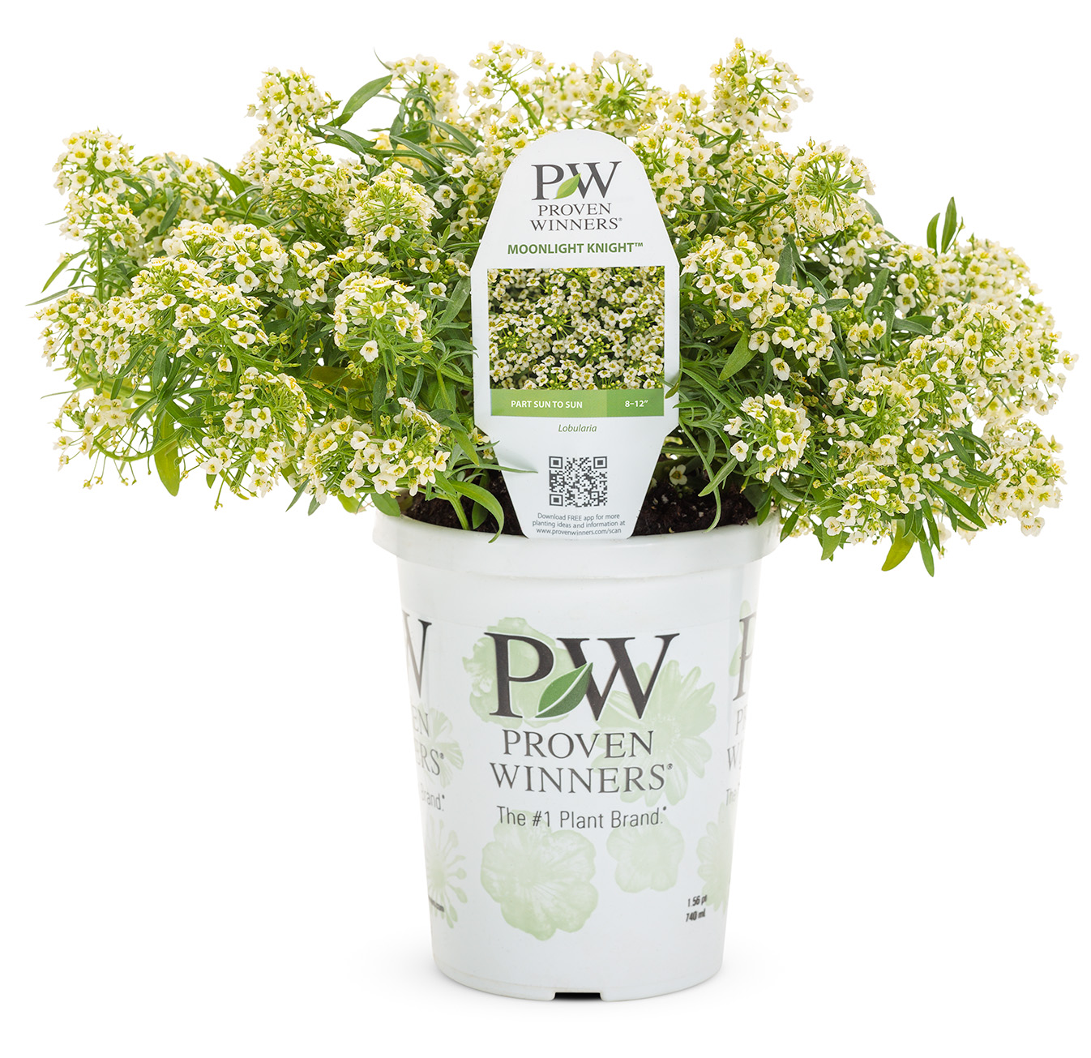
Moonlight Knight™

Slide 51
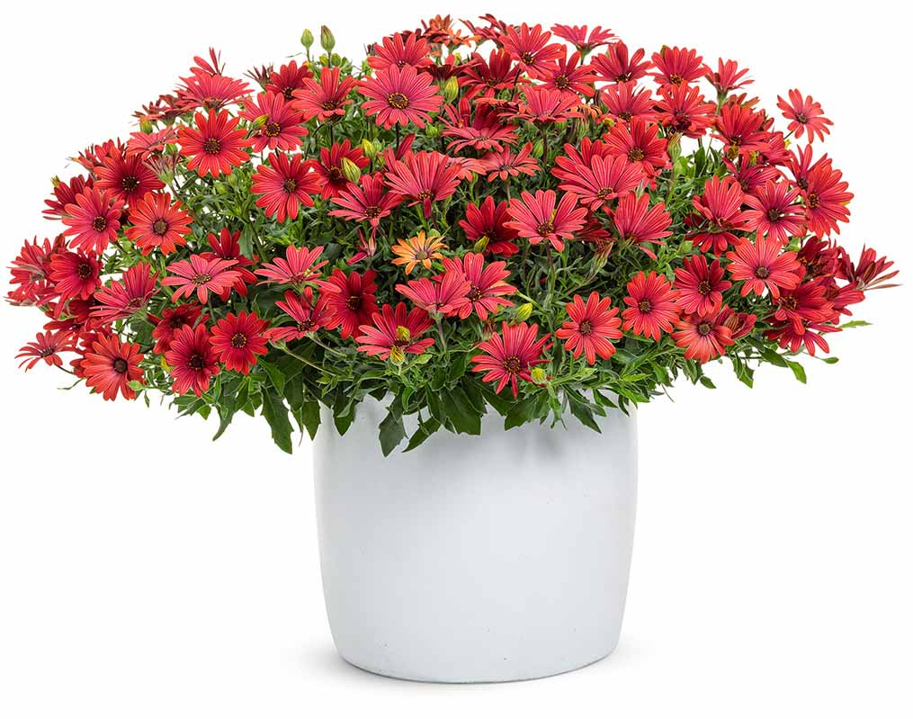
Bright Lights® Red
Osteospermum
WHAT’S NEW
Selected for its nestled branching, fuller, uniform habit and season-long flowering, this brick red selection represents an advancement in heat tolerant Osteospermum breeding.
Color expansion for the series
Longer sales window than most due to heat tolerance
Grow in 4.25 Grande™ containers, recipes, monocultures, grab ‘n go pots
8-12” height; 8-12” spread
Part sun to sun
Vigor 2

Slide 52
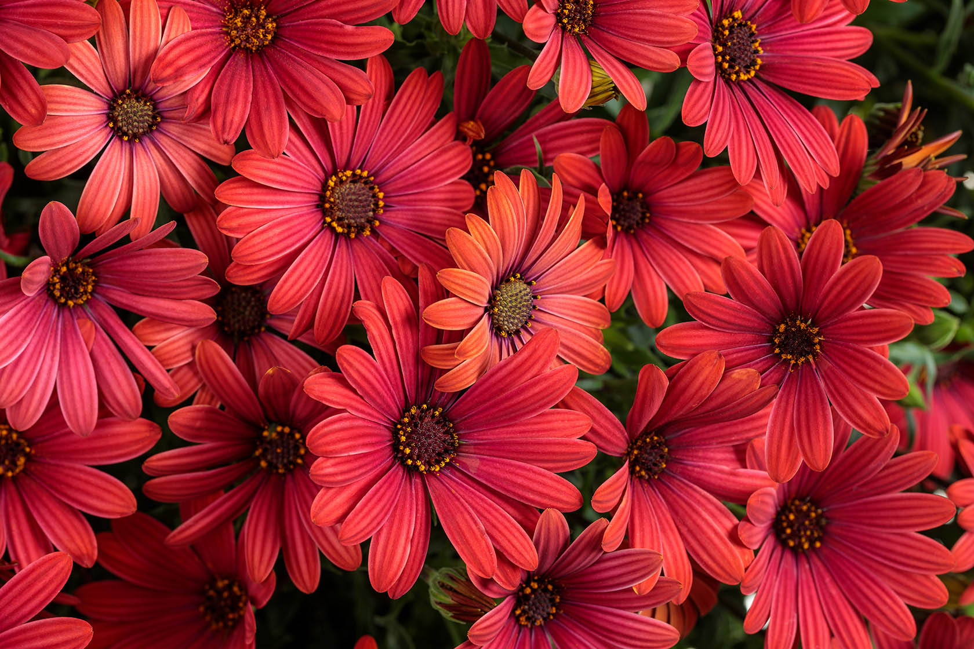
Bright Lights® Red

Slide 53
Bright Lights® Red

Slide 54
Supertunia® Royal Velvet® (Imp)
Petunia
WHAT’S NEW
How do you improve on one of your top selling annuals? By enhancing its spring habit and presentation, ensuring season-long performance, and making its royal purple flowers colorfast.
Excellent heat and humidity tolerance
Durable, all-season performer
Color match to previous Royal Velvet®
Grow in 4.25 Grande™ and 1.0 Royale™ containers, hanging baskets, recipes and landscapes
6-12” height; 18-24” spread
Part sun to sun
Vigor 3

Slide 55
Supertunia® Royal Velvet® (Imp)

Slide 56
Supertunia® Royal Velvet® (Imp)

Slide 57
Machu™ Morado
Ruellia
WHAT’S NEW
We’ve improved upon the classic Mexican petunia by making it behave. Our selection is sterile, non-running, denser and more compact than standard Ruellia, with larger flowers, too.
Essential late season and winter color for the South
Extremely heat, humidity and drought tolerant
Grow in 4.25 Grande™ and 1.0 Royale™ containers, monocultures and landscapes
18-32” height; 10-18” spread
Full sun
Vigor 3

Slide 58
Machu™ Morado

Slide 59
Machu™ Morado

Slide 60
Sunbini® (Imp)
Sanvitalia
WHAT’S NEW
This low maintenance, heat and drought loving annual features an improved summer garden performance, greater color coverage and 30% larger flowers than its predecessor.
Perfect companion for Blue My Mind® Evolvulus
Excellent landscape performance
Grow in 4.25 Grande™ containers, monocultures and landscapes
6-12” height; 12-18” spread
Part sun to sun
Vigor 2

Slide 61
Sunbini® (Imp)

Slide 62
Sunbini® (Imp)

Slide 63
Whirlwind® Starlight™
Scaevola
WHAT’S NEW
This novel bicolor fan flower features blue and white striped flowers on densely branched plants with short internodes for a concentrated show of color.
Heat, humidity and drought tolerant
Similar flower coverage as Calibrachoa and Petunia
Self-cleaning; no deadheading needed
Grow in 4.25 Grande™ and 1.0 Royale™ containers, recipes, monocultures and landscapes
8-14” height; 18-24” spread
Full sun
Vigor 3

Slide 64
Whirlwind® Starlight™

Slide 65
Whirlwind® Starlight™

Slide 66
ColorBlaze® Royale Pineapple Brandy™
Solenostemon
WHAT’S NEW
For polished container presentation, choose this tightly branched, compact selection with radiant golden yellow leaves and a razor thin, red edge.
Exhibits good resistance to downy mildew
Late to no bloom
Grow in 4.25 Grande™ and 1.0 Royale™ containers, recipes, monocultures and landscapes
20-30” height; 12-16” spread
Sun or shade
Vigor 3

Slide 67
ColorBlaze® Royale Pineapple Brandy™

Slide 68
ColorBlaze® Royale Pineapple Brandy™

Slide 69
Proven Harvest™
2020-2021 New Arrivals

Slide 70
Berried Treasure® Pink
Fragaria
WHAT’S NEW
Capitalize on current trends by offering this ornamental and edible, everbearing, patio strawberry. Light pink, semi-double flowers are produced alongside sweet fruits all season.
Compact; ideal for containers
<5% may have white flowers
Grow in 4.25 Grande™ containers, hanging baskets, recipes, monocultures and landscapes
12-16" height; 18-24" spread
Full sun; zones 4-9
Vigor 2

Slide 71
Berried Treasure® Pink

Slide 72
Berried Treasure® Pink

Slide 73
Berried Treasure® White
Fragaria
WHAT’S NEW
Capitalize on current trends by offering this ornamental and edible, everbearing, patio strawberry. White, semi-double flowers are produced alongside sweet fruits all season.
Compact; ideal for containers
Daylength neutral
Grow in 4.25 Grande™ containers, hanging baskets, recipes, monocultures and landscapes
12-16" height; 18-24" spread
Full sun; zones 4-9
Vigor 2

Slide 74
Berried Treasure® White

Slide 75
Berried Treasure® White

